Slide 1
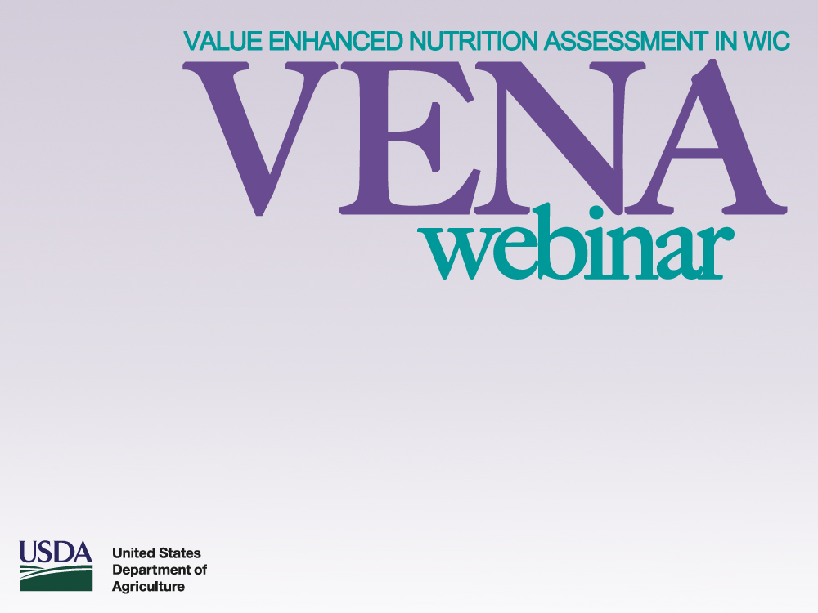
Wednesday, January 29th, 2014
2:00-3:00 PM ET
Audience: All WIC Agencies
Notes:
Welcome and thank you for participating in the Value Enhanced Nutrition Assessment (VENA) webinar. My name is Debra Whitford, I am the National WIC Director. The Food and Nutrition Service is pleased to present this first in a series of webinars with the purpose of revitalizing VENA and to assist State and local agencies in their continued implementation of VENA.

Slide 2

VENA BACKGROUND
2002 Institute of Medicine Report: Dietary Risk Assessment in the WIC Program.
Opportunity to refine and improve entire WIC nutrition assessment process.
VENA Guidance developed by joint FNS/NWA workgroup – issued in April 2006.
Part of the larger Revitalizing Quality Nutrition Services (RQNS) in WIC initiative.
Notes:
First, we thought it would be helpful to review some background information about VENA.
The Value Enhanced Nutrition Assessment (VENA) initiative began in 2003 as a result of the Institute of Medicine (IOM) report: Dietary Risk Assessment in the WIC Program. In its report, the IOM recommended that all women and children ages 2 to 5 years should be presumed to be at dietary risk based on failure to meet the Dietary Guidelines for Americans. In addition to refining WIC dietary risk assessment of as a result of the IOM report, the entire WIC nutrition assessment was refined and improved through VENA.
The VENA Guidance (issued April 2006) was developed jointly by the Food and Nutrition Service (FNS) and the National WIC Association (NWA) and is part of the larger Revitalizing Quality Nutrition Services (RQNS) in WIC initiative. The VENA guidance provides a process for completing a comprehensive nutrition assessment, including the content of such an assessment and an outline of the necessary staff competencies.

Slide 3
VENA BACKGROUND
The goal of VENA: To expand the purpose of nutrition assessment from eligibility determination to improved & targeted nutrition services.
VENA & WIC Nutrition Risk = comprehensive nutrition assessment & individualized nutrition services.
Notes:
The continued/ongoing goal of VENA is to expand the purpose of nutrition assessment from eligibility determination to improved and targets nutrition services. VENA improves and enhances the risk assessment process by ensuring that a complete nutrition assessment continues to be completed to collect relevant information to be used to individualize nutrition services.
VENA and WIC nutrition risks provide a cohesive framework for a comprehensive assessment. WIC nutrition risk criteria provide a foundation by establishing program eligibility for each participant. The VENA guidance provides the process for achieving a consistent and comprehensive WIC nutrition assessment.
While the focus of VENA is to strengthen risk assessment, one of the outcomes is the collection of more relevant information to be used for individualized nutrition services. VENA was developed to align the purpose and scope of a multi-faceted WIC nutrition assessment with targeted and relevant nutrition education to guide and support families in making healthier eating and lifestyle choices. It is meant to be a bridge to enhance and expand nutrition education and other nutrition services provided by WIC. VENA complements the participant-centered strategies that many State agencies have incorporated into their delivery of nutrition education and counseling.

Slide 4
VENA IMPLEMENTATION
VENA implementation envisioned as an on-going process to allow for continual improvement.
FY 2007 - WIC State agency VENA implementation plan.
FY 2010 - VENA implemented.
FY 2014 – VENA II – Revitalizing VENA
Notes:
From its inception VENA represented a paradigm shift in that VENA has essentially changed the way that WIC interacts with applicants, participants and program staff. Health issues are not the same as when WIC was created 40 years ago. Participant risks and needs change over time, as does the scientific knowledge and best practices for methods to improve the health of women, infants and children. VENA allows and encourages the adaptation and enhancement of the program to address new emerging health-related risks while maintaining the original Congressional intent for which WIC was created. As a result, the philosophy of VENA supports the ever-changing needs of participants. Therefore, VENA is an ongoing process so that WIC continues to be effective in its mission and maintains its status as a premiere public health nutrition program.
Implementation of VENA was a gradual process determined by each State agency’s staffing and nutrition assessment procedures. Initially, (in August 2007) each State agency submitted a plan that outlined and projected the implementation of the VENA nutrition assessment protocols by fiscal year 2010.
To highlight the ongoing nature of VENA, FNS has initiated VENA II, or a revitalization of VENA. It’s important to take stock after several years of implementation, refreshing it to accommodate new WIC staff that have come on board since VENA was first launched and implemented.
These webinars are meant to assist State and local WIC agencies in the continual improvement process and part of our revitalizing efforts.
We hope to sponsor a webinar on a quarterly basis. Currently there is a VENA II workgroup consisting of FNS HQ and Regional Office staff. This workgroup will be soliciting ideas from State WIC agencies for future webinar topics.

Slide 5
VENA STAFF COMPETENCIES
VENA Guidance outlines key staff competencies.
VENA Train-the-Trainer and other resources are available on WIC Works Resource System: http://www.nal.usda.gov/wicworks/Learning_Center/Assessment_VENA.html.
WIC Learning-on-Line VENA modules.
Notes:
The success of VENA relies to a large extent on the capacity of WIC staff. The VENA guidance outlines key staff competencies necessary to conduct a comprehensive assessment, e.g., knowledge of nutrition, communication skills, and critical thinking. State agencies need to evaluate staff training needs and build upon existing training systems. Recognizing the need and importance of staff training, FNS provided Regional VENA Train-the-Trainer Training in FY 2006. The training materials are available on WIC Works Resource System. In addition, WIC Learning-on-Line has VENA themed modules.
We are very pleased to kick-off the VENA webinars with a presentation from Iowa WIC. In 2007 Iowa WIC received a WIC Special Project Grant. The focus of their project was VENA implementation - specifically staff training and nutrition assessment competency. Here to describe their project are Brenda Dobson and Kimberly Stanek. I will now turn the presentation over to Brenda and Kimberly.

Slide 6



Strengthening
WIC Nutrition Assessment Skills
Establishing a Competency-to-Training Framework
in a Learning Management System
WIC Special Project Grant FY2007 January 2014
Notes:
Good afternoon. My name is Brenda Dobson and I’m pleased to be able to share information from our WIC Special Project Grant titled (read slide).
6

Slide 7
VENA Self-Evaluation
Nutrition
Assessment
Processes &
Practices
Policies
Quality
Assurance
& Monitoring
Staff
Competencies & Training
Management Information System
Notes:
Our project emerged from the results of our VENA self-evaluation submitted as part of our FY2007 state plan. When the focus for the FY2007 special project grants was announced as Revitalizing Quality Nutrition Services thru the implementation of VENA, we knew we had to pursue the funding opportunity to advance our efforts because well trained personnel are essential to ensure quality WIC nutrition services. In addition, successful and sustained implementation of the VENA policy guidance required a trained and knowledgeable work force. This includes, of course, training for new personnel and ongoing training for existing personnel.

Slide 8
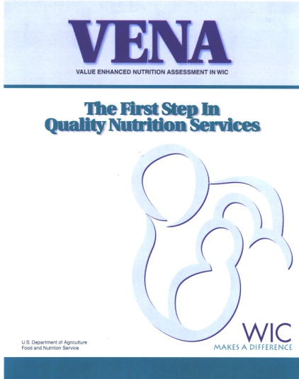
VENA Challenges & Opportunities
Staff competencies were priority focus
Training is principal challenge
Systems approach was needed
Notes:
Staff competencies and training were identified as a priority VENA focus for the IA WIC Program with training identified as the principal challenge.
Historically, Iowa WIC had provided training face to face and via the statewide fiber optics communication network. While face to-face training is often preferred because it allows interaction, it is not feasible to provide all training this way. Travel costs for local agencies are significant and clinic schedules are negatively affected. It also delays the timing of training. Distance learning technologies like the ICN and webinars that have increasingly been used since the project ended, can be effective for short training sessions, but interaction is still very limited.
The Iowa VENA self-evaluation work group recognized that a systems approach was needed to ensure that new and existing staff training needs were met and that limited resources were used effectively.

Slide 9
Project Goals & Objectives
Develop and validate a competency model
and an online self-assessment tool:
  Validate nutrition assessment competencies
  Pilot an online self-assessment tool
  Complete three rounds of CPA self-assessments
  Pilot test & compare supervisor assessments of CPAs
Develop, implement and evaluate an online training and documentation component:
  Identify and link external courses
  Complete competency and training gaps analysis
  Develop, test and post 3 new courses
  Complete a follow-up survey to assess learner retention
Notes:
This slide lists all of the goals and objectives for our project. Today we will focus on two objectives –
Validating nutrition assessment competencies
Developing, testing and posting 3 new online courses

Slide 10
Theoretical Basis
WIC Nutrition Workforce Development Needs
  WIC is primary funding source (88.6%)
  Public health nutrition workforce is increasingly contracted and/or part-time
  WIC nutrition workforce
    Has varied backgrounds
    Is both young and seasoned in experience
  Haughton B and George A. Survey of the Public Health Nutrition Workforce: 2006-07. Johnstown, PA: ASTPHND, 2007.
Notes:
The theoretical basis for our project is grounded is what we know about the WIC nutrition workforce development needs from the surveys conducted by ASTPHND, now known as ASPHN. The 2006-2007 survey results were used for this project with key issues noted on the slide.
While the majority of the WIC nutrition workforce are professionals with discipline-specific core competencies and credentials, local medically trained health officials made up 26.4% of the workforce. This employee group primarily develops their nutrition assessment skills through on-the-job training activities. It is important to note that nurses are not accounted for in this survey and that many nurses provide nutrition services in WIC Programs across the country.
These survey findings supported the need for a validated competency model and aggregate self-assessment data to identify training needs and gaps. In addition, the changing demographics point out the need for just-in-time access to training as well as interactive training that accommodates variations in learning styles.

Slide 11
Why a competency model?
Comprehensive workforce development efforts address training, education, promotion of competencies and their enhancement
Core WIC nutrition assessment tasks are consistent regardless of CPA background
VENA policy guidance provided a foundation
Complements Iowa’s accreditation initiative
Notes:
Current research also supported the transition to competency-based training which is defined as the alignment of training with the outcomes and assessment of worker performance in specific work conditions. Competency-based training requires the identification of knowledge, skills and behaviors as applied in real working settings. Therefore, comprehensive and systems-based workforce development efforts need to address training, education, promotion of competencies and their enhancement.
Developing a competency model also made sense because:
Core WIC nutrition assessment tasks are consistent for all members of the WIC nutrition workforce regardless of their background
The nutrition assessment competencies in the federal VENA policy guidance provided a framework or foundation for this work.
Validating a competency model would also provide support for WIC programs across the country in developing, updating, and revising job descriptions; orienting and training new personnel; planning staff development activities; and evaluating personnel performance.
At this point let me share what I mean when I use the term CPA. For our project, we defined CPAs to include all of the potential WIC staff that function in this role, however the state WIC agency may define CPAs. Therefore, it includes dietitians, nutritionists, health educators, nurses, and state or local medically training health officials – the latter group is sometimes referred to as paraprofessionals.

Slide 12

Web-Based Learning
Navigate at own pace
Just-in-time training
Access when needed
Shorter learning time
Greater retention
Consistent training
Saves travel time
Notes:
The Iowa VENA self-evaluation work group also identified desirable characteristics of an effective WIC training system and that list of characteristics included many of the factors listed on the slide as characteristics of web-based learning. We were already recommending a couple online courses for our CPAs as part of their new employee training so we were familiar with the capacity and limitations of online learning.
At this point it’s important to note that this project did not intend to move our training system to be solely or even primarily web-based learning. Although there are numerous benefits or advantages, there are also limitations and disadvantages including computer requirements for successful course-loading, variations in bandwidth capacity, and the time and upfront costs to develop the courses. More importantly, some training topics are not best served by computer-based training and require a personal touch or hands-on experience. In fact, the expert work groups developing our three courses were sometimes challenged as they developed appropriate content for the courses. Project staff started and ended the project with the understanding that computer-based training can assist the learning process but that it cannot replace methods that already work well. This is reflected in our current WIC training system that includes a combination of web-based learning through online courses, interactive webinars, face to face workshops and continuing education conferences.

Slide 13

Learning Management Systems (LMS)
Analyze needs for training
Access online courses
Access experts and credible resources
Obtain/file CEU transcripts
Receive rapid learner feedback and evaluation
Partner with academia and other public
health programs
Notes:
We recognized that housing the competency model, the online self assessment tool and courses in a learning management system (LMS) would provide access to the WIC community not only in Iowa but across the country as well.
Prepare Iowa is Iowa’s first internet-based LMS for public health and was selected as the home for this project. This LMS came into being when IDPH and Institute for Public Health Practice (IPHP) at the University of Iowa partnered to modify another established LMS to support Iowa’s continuing education registration and data reporting requirements related to emergency preparedness. The LMS platform has changed twice since then – once during the project and again after the project ended with concurrent changes in capabilities and sometimes new limitations.
The IPHP had the LMS infrastructure, staff and program operations in place for this project. The Institute’s systems model approach to public health training and education – assessment, curriculum development and delivery, and evaluation – had successfully supported several other similar projects. And IPHP had extensive experience developing and validating competency sets and the capacity to design, deliver and monitor online courses.

Slide 14
Competency Development and Validation
Competency Work Group 1
12/07 to 3/08
& 7/08
Competency Work Group 2
4/08 to 7/08
Online
self-assessment tool
Pilot 9/08
Open to staff 11/08
Project Advisory Committee
Notes:
This slide describes the process used to develop and validate the competencies. .
Competency Work Group 1 (CWG1) included representation across disciplines (RN, RD, health educator) and different Iowa local agencies (n = 8, all representing IA). This group started with the six general VENA competency statements and the performance expected and knowledge required statements to create competency statements with a consistent format and an appropriate action verb. Knowledge or skill requirements that were missing were added as well. The work group members spent considerable time describing how the competency would be demonstrated in action or observed, resulting in “more information” narrative that supports the competency statements with concrete examples, definitions and links to relevant information. CWG1 also agreed and defined several parameters as standard project elements to guide the development of the model. For example:
Model will address assessment; it will not address nutrition education knowledge, skills and behaviors.
Model should apply to WIC CPAs across the country, not just credentialed health professionals as reflected in Iowa staffing models.
Breastfeeding f competency statements would remain in the lifecycle nutrition domain and not in a separate domain.
Client will be used instead of participant or individual.
The CWG was very intentional about not Iowanizing the content by the terms used or state policy references.
Through a series of surveys using Survey Monkey and scheduled conference calls, the competency statements were created and revised using a modified Delphi technique and ultimately sent on to:
Competency Work Group 2 (CWG2) which included a couple state WIC staff from Iowa and state staff from other states representing a variety of WIC clinic staffing models (CA, CO, MD, and IL) and a USDA regional nutritionist (n = 8). This group reviewed the work of CWG1, checked competency statements for consistency and clarity, edited statements, deleted several statements and added several more statements. They also reviewed the “more information” language and helped to determine the order of statements under each domain so that they flowed logically for the user in the online assessment tool. The final set from CWG2 was shared with CWG1 and Project Advisory Committee members for input.

Slide 15
Competency Model
Domain | Number of Statements
Anthropometric and Hematological | 15
Communication | 11
Critical Thinking | 14
Multicultural Awareness | 12
Nutrition Assessment Process | 15
Principles of Life Cycle Nutrition | 18
TOTAL | 85
Notes:
This table summarizes the number of statements in each domain. It should be noted that the competency levels include novice, proficient and expert levels because the project staff and workgroup members agreed that the model was not for only new/inexperienced CPAs but it was for all CPAs regardless of years as a WIC CPA, education/training, experience, etc.
Final # of competency statements: 85
Started with 67 statements from the VENA policy guidance
CWG1 = 101
CWG2 = 80
Final = 85

Slide 16
Uses of the Competency Set
Self-assessment tool
  Use as part of annual review process
  Support individual professional development plans
  Compile aggregate data for state training plans
  Incorporate into LMS or complete on paper
Competencies
  Draft job descriptions
  Staff development and training plans
Notes:
There are several potential uses for the self-assessment tool containing the competency statements. Because the tool offers a standard measurement system as well as data, it can be used as part of new employee training assessment or the annual performance review process, to support professional development plans at both the individual and organizational level. The tool can be used in a LMS or completed on paper.
Initially we required completion of the self-assessment shortly after hire and then again one year later, with annual completion after that. Unfortunately, the self-assessment tool could not be successfully migrated to the newest LMS platform in early 2013.
The competency statements themselves can be used to draft job descriptions and guide the direction of organizational staff development and training plans including orientation, new employee training and continuing education.
Ideally, the model should be reviewed/revisited every 5 years to incorporate changes, new information and practices. One example for future work is related to the breastfeeding competencies. During the course of the project two sets of core competencies in breastfeeding were released – once related to the USDA Peer Counseling curriculum and the second from the US Breastfeeding Committee. We recognize the release of the breastfeeding competencies

Slide 17
Defining Topics for Courses
Aggregate data from CPA self-assessments
Environmental scans
Additional feedback about multi-cultural awareness
  WIC Coordinators
  Online survey for local agency CPAs
  Subject matter experts
Notes:
Our first consideration was the aggregate data from the Phase 1 CPA self-assessments with input from the Project Advisory Committee and the project staff. The online self-assessment tool used a Likert scale which allowed us to calculate average skills gaps for each competency statement and for each domain. We also calculated the skills gaps by job title (nursing vs. nutrition). There were significant skills gaps for or the competency statements related to hematological data collection and assessment and for the Multicultural Awareness domain.
At the same time, we completed an environmental scan of available online courses that revealed that there were no courses on these topics available that related specifically to nutrition assessment. We chose to focus on hematological data collection for the first course because the content was more clearly defined by program policy and other documents. This also provided some time to better understand the staff training needs for the multicultural awareness competencies.
I met with the WIC coordinators to get more feedback about the multicultural awareness skills gaps, the project staff conducted an online survey for local agency staff, and we consulted with subject matter experts in the state and in our special project grantee group to help identify the appropriate focus for a course relevant to this domain. We learned that overall, respondents had based their self-assessments on their current knowledge and understanding of the cultural groups in their service area even though several competency statements were more related to their skills in cross-cultural communication, assessment and identifying resources. This led to defining the focus for the second course as developing cultural competence, cultural influences on feeding and eating, and identifying reputable resources.
When the aggregate results for Phase 3 of the CPA self-assessments reported the largest skills gaps as nearly identical to Phase 1, the Project Advisory Committee and project team concluded that the third course would focus on cross-cultural communication skills in nutrition assessment.

Slide 18

Goals for the Online Courses
Approximately 2 hours to complete
Content in chunks or modules
Stop/start and progress is saved
Interactive components for different learning styles
Emphasis on critical thinking skills
Content relevant to CPAs across the country
Content relevant across practice settings
Pre-/post-tests and other review strategies
PDF files so learners can print
Nursing and dietitian CEUs
Notes:
This slide lists the goals the project team had for the courses developed during this project.

Slide 19

Development Process
Subject matter experts + project staff: Objectives, learning objects, script &reference materials
Technical staff: Instructional activities
Local WIC agency CPAs + one state nutrition consultant: Course pilot tests
Test item writers: Pre/post-test questions
Project staff: Test item analysis
Notes:
The development process involved many individuals as outlined on this slide.
Project Advisory Committee members helped identify subject matter experts and often reviewed the courses, although not as members of a pilot test group
A variety of instructional effectiveness strategies were used in the courses including:
Securing the attention of the learner (reception)
Informing learners of the objectives (expectancy)
Providing guidance via interactive activities
Eliciting performance (responding)
Assessing performance (pre-post tests and other application activities)
Enhancing retention and transferability: games, scenario-based assessments, etc.
Collaboration: discussion boards
The courses were pilot tested by the intended end-users and revised based on their feedback.
Pre-test questions were standard and always the same. Three post-test questions were written for every objective and pooled in a bank of questions that were randomized for each post-test.
Test item analysis was based on statistics provided by the content management system. In general, the difficulty levels for pre- and post-tests were balanced with an average score of 80% or above. Some pre-test items had to be revised to increase their difficulty level; some post-test items had to be revised because they were too hard. A post-test score of 80% or higher was required for the CEU certificate. This was consistent with other courses housed in the LMS.

Slide 20
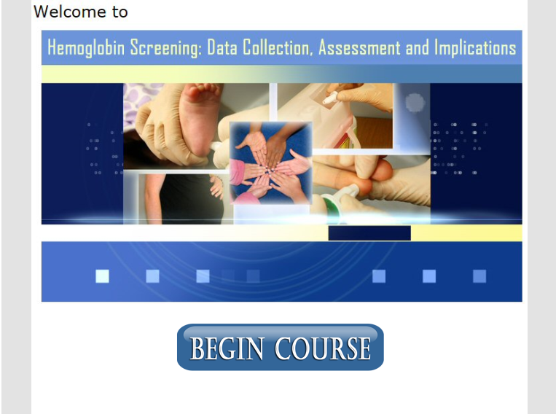
Notes:
My name is Kimberly Stanek and I will now be talking about the three courses that were developed. I will talk a little bit about the content of all three courses and how to access them.
The first course that I will be discussing is the course titled “Hemoglobin Screening: Data Collection, Assessment and Implications”.

Slide 21

Course 1 Overview
Goals
CEUs
Released: August 2009
Transferability
  Varying staffing models
  State policies
Notes:
The goals of this course are to reinforce appropriate hematological data collection techniques, to enhance the ability to critically think about hematological assessment data, and to increase one’s awareness of state policies regarding hemoglobin screening and assessment.
This course has been approved for .24 nursing CEUs and 2 CPEUs for dietitians.
It was released for use in August 2009
This course is very transferable. It is applicable to any health professional who completes hemoglobin collection and assessment and it would apply to any state WIC Program. For example, the course does not reference any specific Iowa WIC policies, the course doesn’t specify who is completing the hemoglobins, such as a nurse or dietitian, and Iowa’s WIC computer system is not shown or discussed at all in the training.
This course is divided into 4 main sections. The first section covers the blood collection schedule for women, infants and children, discusses the rules and exceptions for blood collection, and covers how to use referral data.

Slide 22

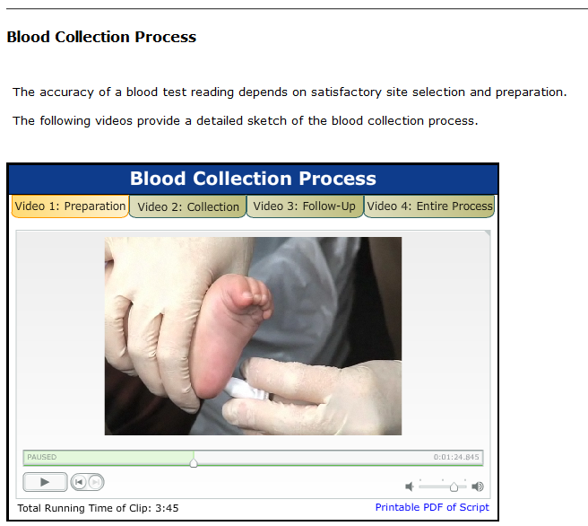
Notes:
The second section of the course covers collection techniques and Universal Precautions. After completing this section, individuals will be able to identify the appropriate puncture sites for blood collection and describe the collection procedure, including appropriate use of wearing gloves.
As you can see on the screen, this section provides videos that demonstrates the blood collection process that provides nice visuals for participants completing the course.

Slide 23
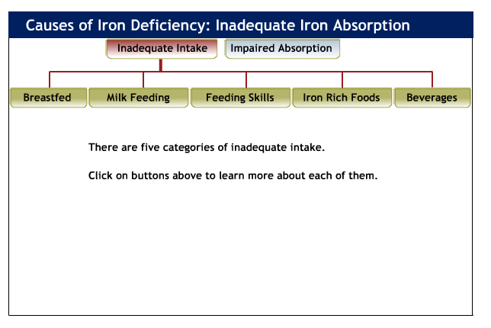
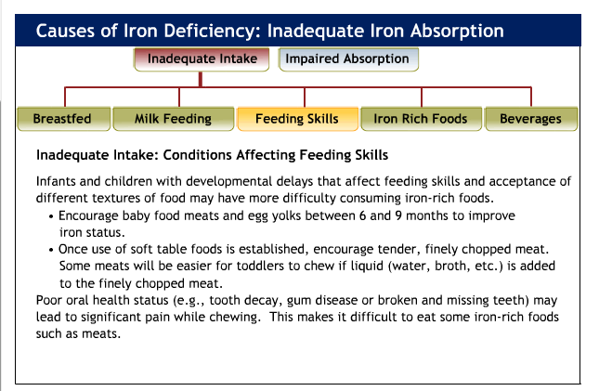
Notes:
Section 3 focuses on hemoglobin reference ranges and related health conditions. This section discusses high and low hemoglobin and hematocrit levels in women, infants and children, discusses appropriate referral criteria for abnormal blood values (both high and low levels), and discusses nutritional factors that affect hemoglobin levels.

Slide 24
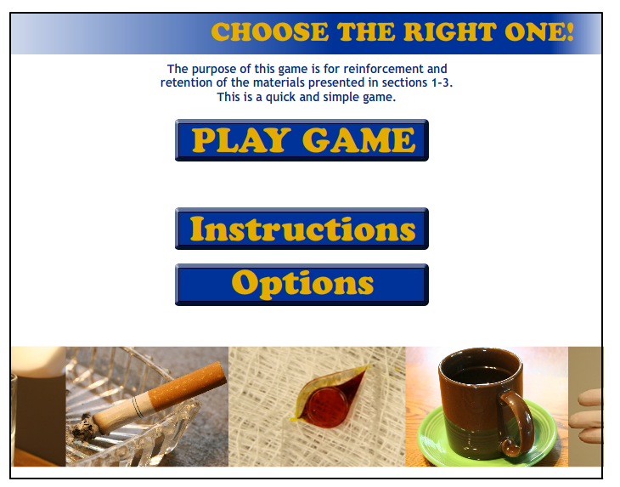
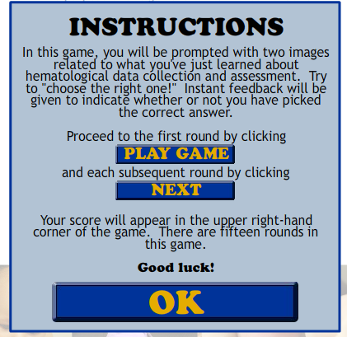
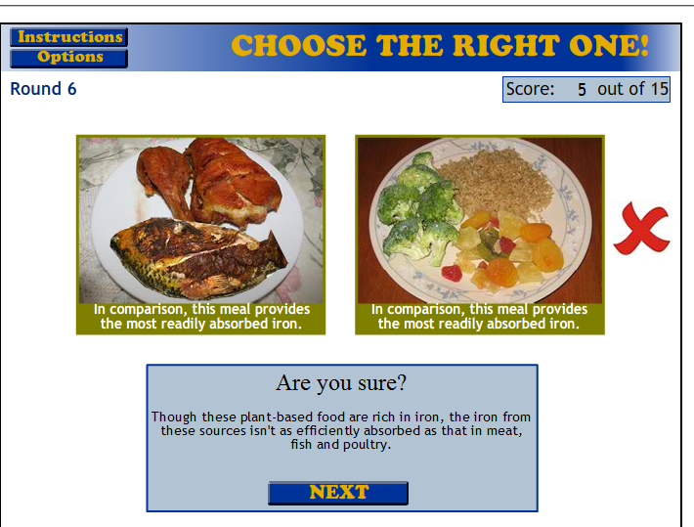
Notes:
The fourth section focuses on critical thinking applications of hemoglobin collection and assessment and describes situations where lifestyle and nutrition factors can affect hemoglobin levels.
As you can see on the screen, this course is also very interactive. This screen illustrates a game that the user plays that reinforces the information presented in the course.

Slide 25

Notes:
The next course I will be discussing is titled Recognizing Cultural Influences on Food Beliefs and Practices.

Slide 26

Course 2 Overview
Goals
CEUs
Released: July 2010
Notes:
The goals of this course are to define cultural competence and discuss why it is necessary in practice, provide examples of eating practices from various cultures, specifically in the context of the WIC food package, and increase awareness of resources, (at the local and national levels) that enable WIC personnel and any health care provider to improve services to diverse populations.
This course is approved for .24 nursing CEUs and 3.0 CPEUs for registered dietitians. There are many web-based resources throughout this course that have contributed to the number of CPEUs available for this course.
This course was released in July 2010.

Slide 27
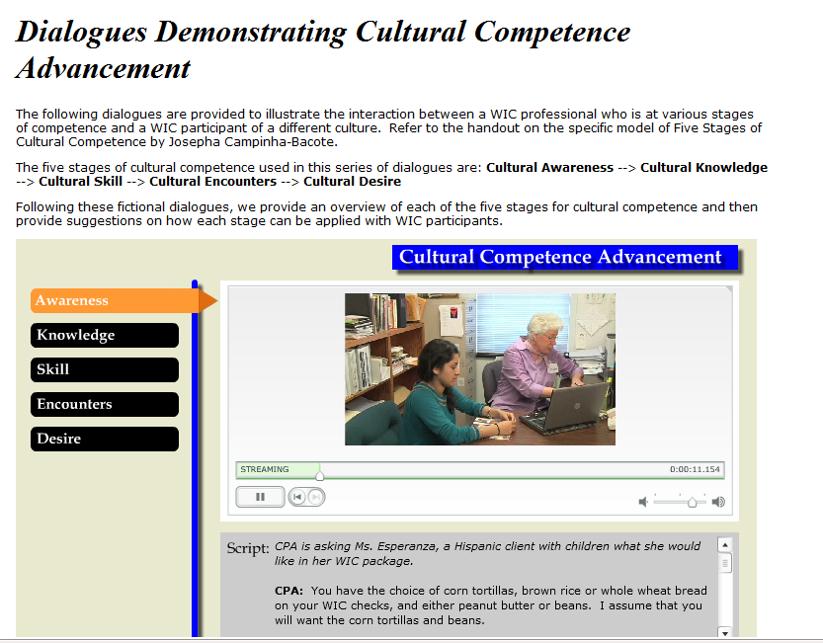
Notes:
This course is divided up into 3 sections. The first section focuses on cultural competence. This section defines culture and acculturation, it discusses the trends in changing demographics and how they apply to WIC participants, and discusses the process of cultural competence, and how your own beliefs and values might affect your behavior and attitude toward a WIC participant or the participant’s beliefs and values.
As with the hemoglobin course, this course contains videos to reinforce the information being presented. This screenshot is of a video that shows the interaction between a WIC participant and a WIC professional who is at different levels of cultural competence.

Slide 28
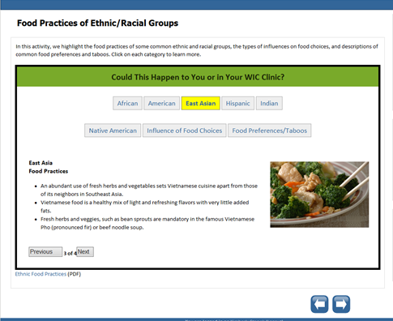
Notes:
Section 2 focuses on how different cultures may have different feeding and/or eating practices and beliefs. It also discusses how culture can affect a WIC participant’s attitudes toward health and illness. Different cultures may have different views about pregnancy, breastfeeding, and healthcare and some of these differences are reviewed. Information presented in the course will also help a health professional determine what kinds of questions to ask a participant of any culture about their eating practices and beliefs and will help them recognize how this can affect the WIC food package that is provided.

Slide 29
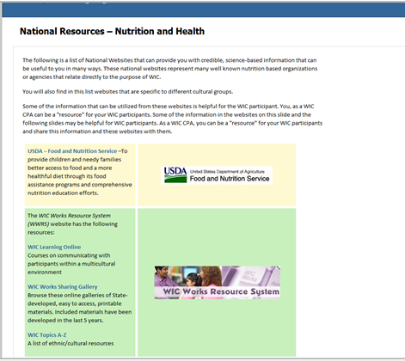
Notes:
The third section of the course focuses on resources, both local and national, that the learner can use about different cultures, the types of foods different cultures typically eat, and their food preparation techniques. The course can also help the learner identify reputable culturally appropriate resources that can be provided to WIC participants. Information on how to evaluate resources found on the Internet is also discussed.

Slide 30

Notes:
The third course I will be discussing today is the course titled “Cross-Cultural Communication and Nutrition Assessment.

Slide 31
Course 3 Overview
Goals
CEUs
Released: September 2010
Notes:
Individuals completing this course will be able to define cross cultural communication and understand why it is necessary in practice, they will be able to provide examples of effective communication techniques when completing nutrition assessments, and they will be able to identify appropriate communication strategies when working with participants that have a language difference. WIC personnel who have more awareness of cross-cultural communication are able to provide a more enhanced assessment and rich counseling experience with participants.
This course is approved for .24 Nursing CEUs and 2 CPEUs for dietitians.
This course was released in September 2010, soon after the last course we discussed.

Slide 32
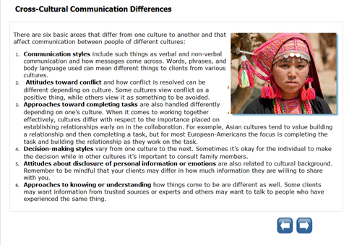
Notes:
This course is also divided into three sections. The first section focuses on the importance of cross-cultural communication and communication techniques. This section will help the individual completing the course recognize how their culture and background may influence their communication skills during a nutrition assessment. Building a relationship with trust and rapport is discussed as well as information about using active listening skills and being aware of non-verbal cues.

Slide 33
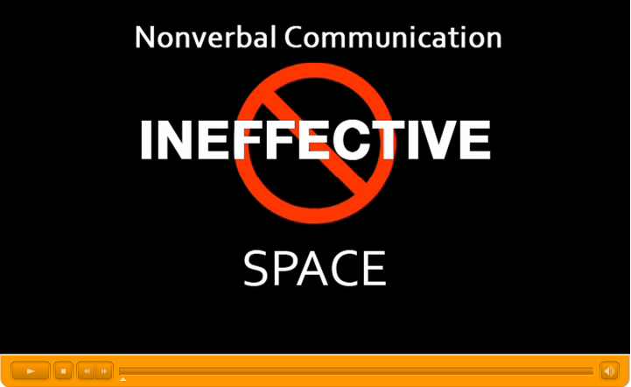
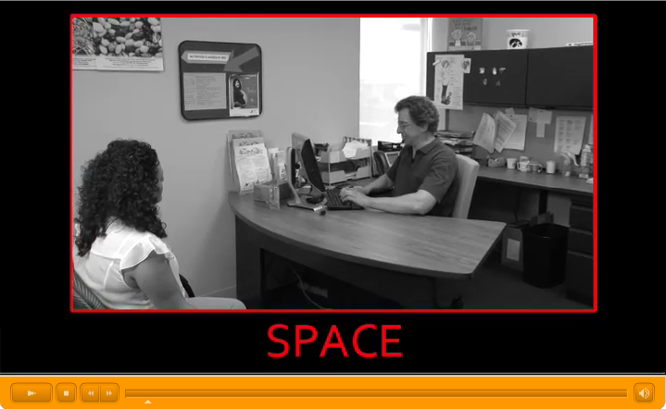
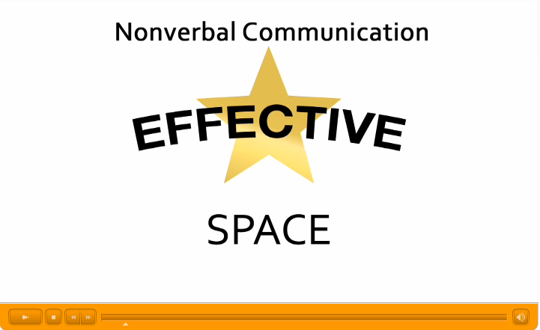
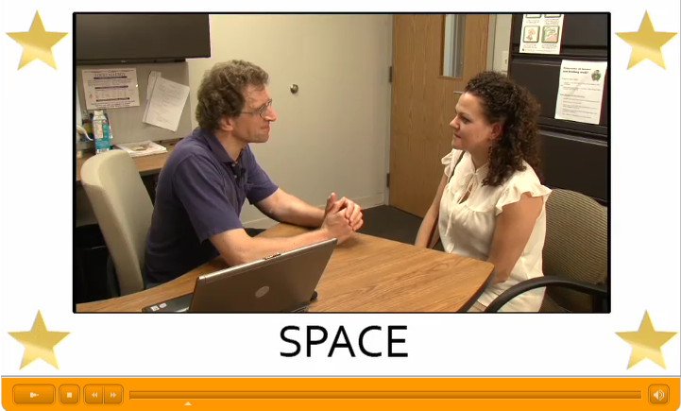
Notes:
As with the previous courses, this course is very interactive. Various video clips were created demonstrating non-verbal cues and how they can affect working with a participant.
There are also questions throughout the course for the individual completing the course to answer regarding things like effective communication techniques they have used, what cross-communication challenges they have experienced, and how they have established trust and rapport with participants. Answers to these questions are posted within the course so attendees can read past responses and individuals can receive future responses e-mailed to them as they are posted as well.

Slide 34
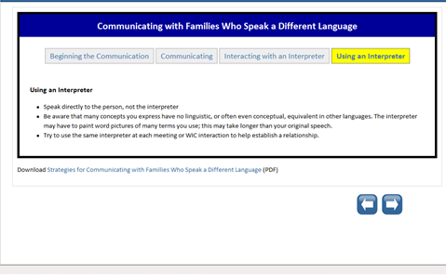
Notes:
The second section focuses on communicating with participants with different languages, hearing impairments, and low literacy or health levels. Effectively using interpreters is also discussed in detail. As with the other courses, interactive activities are also included in this section to help reinforce the information provided.

Slide 35
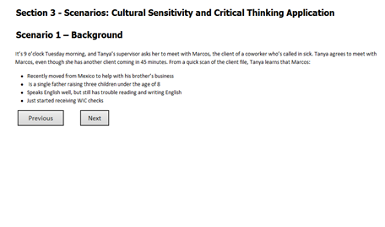
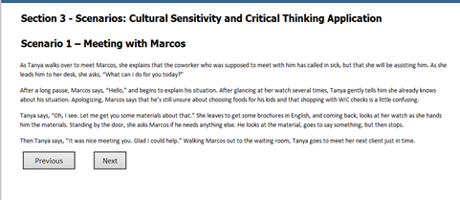
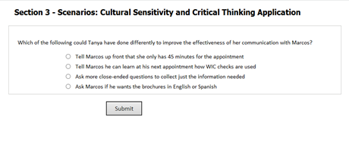
Notes:
The last section allows the user to practice cultural sensitivity and critical thinking skills when completing a nutrition assessment through specific scenarios that are provided.

Slide 36
Project Data
Course Utilization
  Hemoglobin Screening: Data Collection, Assessment and Implication
    299 enrolled; 169 completed; 111 requested CEUs
  Recognizing Cultural Influences on Food Beliefs and Practices
    165 enrolled; 79 completed: 37 requested CEUs
  Cross-Cultural Communication and Nutrition Assessment
    247 enrolled; 167 completed; 45 requested CEUs
Notes:
This slide shows you the number of individuals who have enrolled in each of the courses, how many have completed the courses, and how many have requested CEUs since the courses were implemented.
It has been reported to us that for the
Hgb Screening course, 299 enrolled, 169 completed, 111 requested CEUs
Recognizing Cultural Influences course: 165 enrolled, 79 completed, 37 requested CEUs
Cross-Cultural Communication course: 247 enrolled, 167 completed, 45 requested CEUs
Many individuals completing the courses are from an Iowa WIC Program, but we also see Iowa individuals who are non WIC employees completing these courses as well as individuals from other states.
As you can see, there is a difference between the number individuals enrolling in the course and the number of those completing the courses. It is possible that individuals may have chosen not to complete a post-test that would be required to request CEUs and to officially complete the course. It is also possible that an individual just chose to review specific sections and chose not to complete the whole course. These could be a couple reasons for these differences.
Evaluations completed for all of the courses have been very positive. Participants taking the course find that the material is clearly presented, that objectives are met, and the videos, scenarios, and interactive pieces of the courses are very helpful to aid in their learning process.

Slide 37
Course Requirements
Iowa WIC Staff
Iowa State University – Dietetic Interns
Notes:
It is required for the local Iowa WIC CPAs to complete all three of these courses. Staff are required to take the Hemoglobin Screening course at the time of hire and then every two years thereafter. It is also required for staff to complete this course before a New Employee Course that the state office provides to new staff members. Points from the course are reviewed during this training. This allows us to reinforce the content of this course.
The Recognizing Cultural Influences and Cross Cultural Communication courses are required for CPAs to take within the first year of hire. These two courses were originally recommended for local CPAs to take, but are now required, so I would expect to see an increase in the number of individuals completing these two courses and in monitoring the number of individuals requesting CEUs, we have seen an increase in individuals completing these courses.
These courses are also mandatory for approximately 55-60 dietetic interns who attend the Iowa State University Dietetic Internship program.

Slide 38
Accessing the Course
Prepare Iowa Training-Source
http://prepareiowa.training-source.org/
WIC Works Resource System: Sharing Gallery – Special Project Grants
http://www.nal.usda.gov/wicworks/Sharing_Center/gallery/special_grants3.html
Notes:
These three courses are housed through the Prepare Iowa Training-Source website that can be accessed through the website listed on the screen.
The courses can also be accessed through the USDA’s WIC Works Resource System. The WIC Works website will take you to the Prepare Iowa Training-Source website.
These courses can be accessed 24 hours a day, 7 days a week from any computer with Internet access. The Prepare Iowa Training-Source is publicly accessible. Learners must create user accounts to enroll in the courses, which is free and the courses we discussed today are free as well.
If you would like to enroll in a course after getting into the Prepare Iowa website, it is best to search for the actual title of the course. This will help ensure that you find the specific course you are looking for.
Once a course is completed, certificates of completion can be printed off, as well as transcripts showing course completion information.
CEUs have been renewed until 2016 for all three of these courses and as mentioned before are available for nurses and dietitians , however these course are definitely applicable to professionals who do not require CEUs.

Slide 39
Identify External Courses
Attractiveness – Design principles used effectively, same fonts used consistently and font size appropriate for screen sizes
Organization – Goals/objectives stated clearly, navigation clear and logical, learner knows what to do and is expected of them
Interactivity – Clean page layout and not distracting, variety of course activities, no broken links, content appropriate for learner, content not too heavy on text
Accessibility – Course accessed easily, redundant navigation, alternate formats for screen readers
Notes:
One of our other project objectives was to identify and link additional external courses that were relevant to the nutrition assessment competency model. Essentially this meant providing a link in the LMS so that learners could find all of the courses and links in one location. This would also provide greater flexibility for learners to learn at their own pace.
At the outset of the project, we were already using several courses including WIC Works and the growth chart courses at CDC and MCHB as part of our new employee training program. Throughout the three year project, external courses were reviewed using the criteria listed above and keeping in mind the goals that we had set for developing our own courses. It should be noted that these criteria are parallel to the criteria for developing and evaluating electronic-based nutrition education for WIC clients. Courses were also evaluated for technical feasibility for linkage. Well over 200 courses were reviewed including courses from traditional public health sources, other state WIC programs, academia and others.
Some issues encountered while reviewing courses –
Limited access to outside users
Courses offered in PDF format as self-study, not as online modules with interactivity
Courses with numerous references to specific state policies and procedures that limited applicability to other learners
Challenges contacting representatives to discuss possibility of linkage

Slide 40
Topics in Linked External Courses
Cross-Cultural Communication
Growth Charts
Nutrition for Children with Special Health Care Needs
Health Literacy & Public Health
Nutrition and Oral Health for Children
WIC Learning Online Modules
Notes:
This slide lists the topics available in the current linked courses. A couple courses are no longer available due to being removed from the web or being moved to a state LMS that is not publicly accessible; those courses addressed the topics of Nutrition and Pregnancy and Client-Centered Counseling. It should be noted that several links provide access to a number of courses, most notably WIC Learning Online.
All of the linked courses include application and review activities and can generally be completed in 60 minutes to 2 hours. Each course allows learners to stop/start. Many also provide CEUs for a variety of health professionals.
These courses are available in LMS by searching by title. We are exploring creating a portal on the homepage of the LMS for WIC courses. This would basically group all of the courses relevant to WIC staff to make them easier to find in the system.

Slide 41


Project Team
Project Coordinator: Brenda Dobson, MS, RD, LD Project Coordinator brenda.dobson@idph.iowa.gov Iowa WIC Program Iowa Department of Public Health 515. 281.7769 | University of Iowa College of Public Health Project Team: Dawn Gentsch, MPH, CHES Education Coordinator With project 10/1/07 - 5/19/10 ddgentsch@msn.com Diane Heckman, Kylie Davidson, Maria Osterhaus Scott and Maureen Myshock Project Assistants Nor Abd Hamid, PhD and Dena Fife, MA Instructional Designers Tanya Uden-Holman, PhD Evaluation Coordinator tanya-uden-holman@uiowa.edu 319.384.5489
This project funded at least in part with Federal funds from the U.S. Department of Agriculture, Food and Nutrition Service.
Notes:
This slide lists the members of the project team. However, this project involved many others including:
Iowa WIC Program
State WIC agency staff
Local WIC agency staff from 19 of 20 contract agencies; more than 100 staff were involved in some role including WIC Coordinators, licensed dietitians, nutrition educators and registered nurses
Other WIC Program staff from
Mountain Plains Regional Office
State WIC Programs in California, Illinois, Kansas, Maryland, Nebraska, North Dakota, Utah and Wisconsin
And last but not least, our Project Advisory Team including state WIC staff, local WIC staff and a representative from the ISU Dietetic Internship Program
We believe this broad-based involvement of WIC staff resulted in a competency model and courses that are relevant to staff and programs across the nation.

Slide 42

For More Information
Kimberly Stanek, RD, LD
kimberly.stanek@idph.iowa.gov
515.281.7119
Brenda Dobson, MS, RD, LD
brenda.dobson@idph.iowa.gov
515.281.7769
Notes:
If you would like more information about the project or have additional questions after the webinar, please contact us using the information on this slide.
We are interested in hearing your questions and comments about the competency model and the courses so would like to pass the webinar control back to Kurtria to open the question and answer session.
Thank you.

Slide 43
Additional Questions
If you have additional questions about Iowa WIC’s project, please contact Brenda Dobson:
    brenda.dobson@idph.iowa.gov
    515.281.7769
If you have questions about VENA in general please contact your respective FNS Regional office.

Slide 44
Thank you!
Thank you for your participation.
Thank you for your hard work.
Stay tuned for the next webinar.
Notes:
Thank you for joining us on today’s webinar. Also, thank you for your hard work.
Please stay tuned for the date and topic of the next webinar.

