Slide 1
Wednesday, May 28th, 2014
2:00-3:00 PM ET
Audience: All WIC Agencies
Notes:
Welcome and thank you for participating in the Value Enhanced Nutrition Assessment (VENA) webinar. My name is Debra Whitford, I am the National WIC Director. The Food and Nutrition Service is pleased to present the second in a series of webinars with the purpose of revitalizing VENA and to assist State and local agencies in their continued implementation of VENA.

Slide 2
The VENA Journey in Massachusetts—From Theory to Practice
Lynn Beattie, MPH, LDN, CLC
Rachel Colchamiro, MPH, RD, LDN, CLC
Corey Greene, CLC
Notes:
We are grateful for the opportunity to share Massachusetts’ VENA journey with you. I (Rachel Colchamiro) am the Director for Nutrition Services at the Massachusetts WIC Program. Lynn Beattie is one of our Nutrition Education Specialists. Corey Greene is a nutritionist and breastfeeding coordinator at a local WIC program in the Boston area.

Slide 3
Massachusetts WIC
Serving ~125,000 participants monthly
35 local agencies providing services at 120 sites
39% Hispanic
22% Black, 6% Asian/ Pacific, <1% Native American, <1% Native Hawaiian/Other Pacific, 67% White and 3% Multiple Race
1,000 vendors (grocery stores and pharmacies)
~600 staff including peer counselors; paraprofessional model
Notes:
We thought it would be helpful to provide a brief description of the WIC Program in Massachusetts. We serve a diverse group of participants and operate the program across a relatively large group of local agencies, considering our geographic size.
Of note is our paraprofessional model. We hire staff from the community and provide significant training that allows them to provide nutrition services low-risk children. Our training center offers additional training that paraprofessionals can take that prepares them to provide nutrition services to low-risk infants and women as well. We also provide an opportunity for paraprofessionals to enroll in an Associate’s Degree program that prepares them to sit for the DTR exam.

Slide 4
Changing Our Ways
Traditional approach to nutrition services…
Step by step, sequential
Logic and fact based
Deficiency oriented
Tells people what to do…
WAS NOT WORKING!
Not relevant or “connecting”
Doesn’t capture participants’ attention or lead to positive behavior change
Lecturing and making people feel deficient (bad mom)
Notes:
A little more than ten years ago, Massachusetts WIC conducted focus groups with staff and participants to get a handle on how people felt about the nutrition services provided by the program. We discovered that the step-by-step, fact-based model we offered was often focused on pointing out what people were doing wrong, and came across as telling people what to do. This model was not working. Participants did not feel that the nutrition education we were providing was relevant; rather, they felt we were lecturing and making them feel badly about their parenting. Nutrition staff didn’t feel that they were able to create behavior change in this environment.

Slide 5
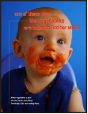
Touching Hearts, Touching Minds 2003 WIC Special Project Grant
Developed materials that created a relevant benefit to changing behaviors
Improved nutrition staff counseling skills
New emotion-based style
Open, Dig, Connect, Act conversational approach
Rolled out statewide in 2007:
Revisions to certain Management Evaluation components to reflect new emotion-based services
Implemented VENA
Notes:
Our results led us to apply for the 2003 Special Projects Grant to develop our Touching Hearts, Touching Minds project. We were very lucky to work with Pam McCarthy on this project.
A key part our of project was to design nutrition education messages that connected with mothers’ emotional pulse points. Through many focus groups we had determined that there were several universal pulse points that guided mothers’ decision making: making their families happy, providing a better future for their children, keeping their children safe and creating positive memories. We designed a series of 30 nutrition messages for use in WIC clinics.
Additionally, we trained staff to provide more participant-centered, emotion-based counseling. As VENA was unveiled around the same time we launched Touching Hearts, Touching Minds, we were able to rollout VENA statewide in the Spring of 2007.
At that time, we provided staff with a hard copy questionnaire focused on eating behaviors and food group patterns. Staff used the questions and added free text notes to document their nutrition assessments.

Slide 6
A VENA for Massachusetts
Getting to the Heart of the Matter
This project and its tools were created to foster a genuine connection between participant and counselor and becomes a powerful springboard to effective nutrition education, using emotion-based techniques that make people feel understood and respected.
Notes:
While the changes to our nutrition education were evident, we realized that there continued to be a disconnect between VENA and the nutrition assessment services that we provide in Massachusetts. VENA needed to be looked at as more than a series of questions to be asked and answered.
We applied for the 2007 WIC Special Project Grant to implement our Getting to the Heart of the Matter project, again working with Pam McCarthy, to explore how we could make our VENA more aligned with the emotion-based, participant-centered counseling and education we were offering.

Slide 7
Getting to the Heart of the Matter 2007 WIC Special Projects Grant
Three goals:
Identify changes needed to current assessment process to achieve an emotion-based, participant-centered interaction
Develop and implement emotion-based nutrition assessment tools and techniques
Supportive of VENA principles
Provides structure for parents to identify hopes and dreams for their child or themselves
Connect emotion-based desires (‘pulse points’) with eating and activity behaviors
Deliver materials and training that combines VENA principles and emotion-based techniques
Notes:
We had three goals in mind when we launched our Getting to the Heart of the Matter project.

Slide 8
Getting to the Heart of the Matter Timeline
2008
Ethnographic Research
Focus Groups (participant and staff)
Pre-Pilot Surveys
2009
Pilot emotion-based assessment tools and techniques
2010
Post-Pilot Surveys
In-Depth Staff Interviews
Ethnographic Research
Focus Groups
Final Strategies and Techniques
2011
Statewide Training and Website development
Task Force launch
2012-now
On-going “refresher” trainings, task forces, technical assistance and support
Integrated into new staff training
Notes:
Here is an overview of the project’s timeline.
Ethnographic research was a process by which the evaluators were “flies on the wall” at the WIC clinic, noting interactions between staff and participants from the beginning to the end of the visit. Participants were also interviewed after they had completed their WIC appointments. We conducted ethnographic research before and after our pilot.
You can see that we continue to work on the project today.

Slide 9
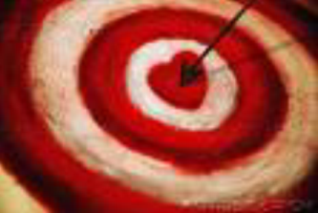
Getting to the Heart of the Matter Pilot
6 local programs: Berkshire South, Chelsea/ Revere, Dorchester North, Holyoke/ Chicopee, North Suburban and Springfield North
Piloted for close to 2 years
What pilots said:
“I feel that the tools have helped get to the heart of the matter, much quicker, instead of tip-toeing around or dancing around. And I feel like it makes it more interesting for us, the nutritionist, and for the patient, because it‘s something new.”
“With the VENA [form], it‘s like the same old questions. But with the tools, it‘s more like...the participant can tell you whatever they want.”
Notes:
We piloted our project in a diverse (urban/rural, large/small, Eastern MA/Western MA) set of local agencies for an extended pilot phase.

Slide 10
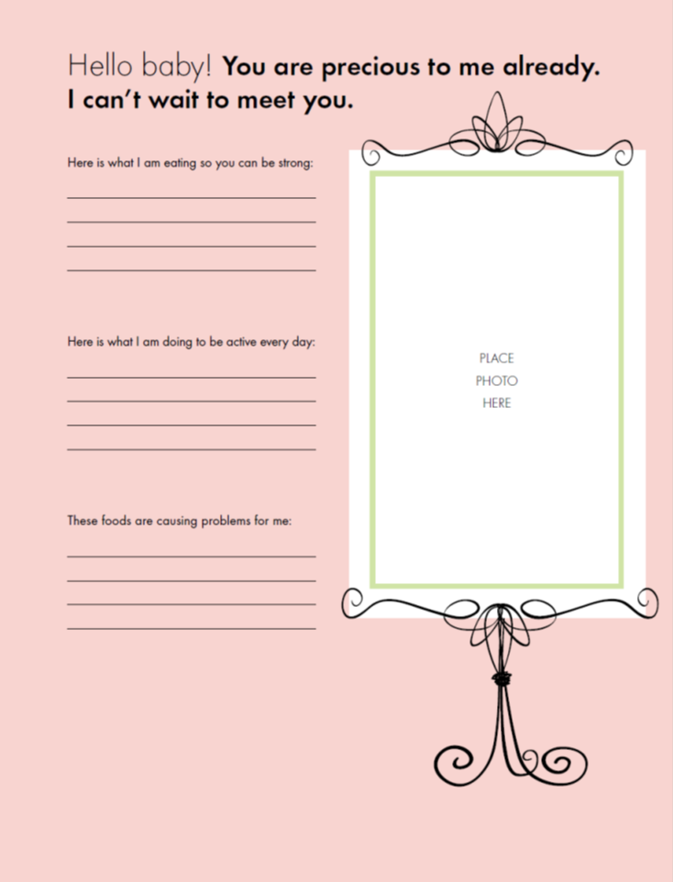
Baby Book
Notes:
While more tools were piloted, MA decided to roll out with the 7 most effective tools that the pilot programs felt were the most successful during the pilot phase.
The baby book is one tool that is a unique way for the nutritionist to start a conversation with a participant that leads to a nutrition assessment and provides parents with a wonderful gift for them to bring home and record their child’s milestones.

Slide 11
Baby Book
In addition to helping parents keep track of important events in their child's life, the WIC Baby Book can serve as a unique nutrition and activity assessment. The pages include topics such as feeding plans, maternal diet and physical activity, breastfeeding and introduction of solids.
Some mothers might prefer to complete the baby book at home.
The baby book prompts can be a useful tool even when the answers have not yet been recorded. Acknowledge the mother's preference and proceed to ask how she plans to respond to each prompt, using her answers as a jumping off point for the assessment.
Notes:
There are pages for the baby book that correspond to the mother’s pregnancy and child’s age. Each page prompts the dialogue to include topics such as feeding plans, maternal diet, physical activity, breastfeeding and introduction to solids.
As we go through, I am mostly sharing experiences of using the tools individually in nutrition sessions. But, programs have found using the tools in group appointments works well too. For example, one of our smaller WIC programs began a scrapbooking group for mothers using the baby book. They were able to share their responses to pages while engaging in an activity together.
An example of utilizing the baby book is to have mothers fill out a page in the waiting room. However, some mothers prefer to complete the pages at home.

Slide 12
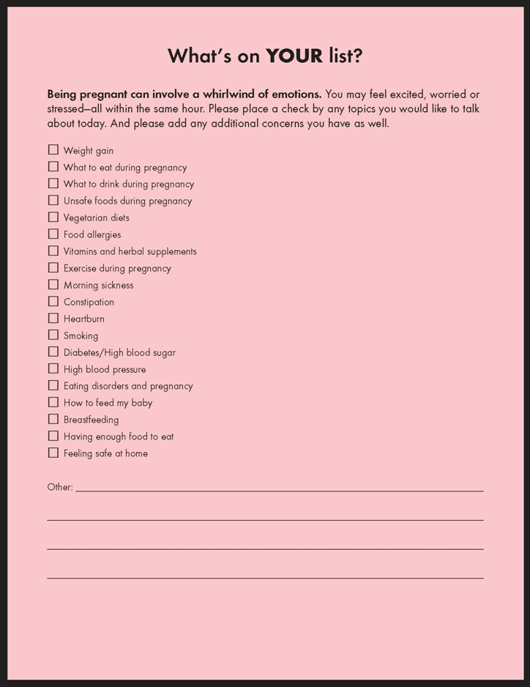
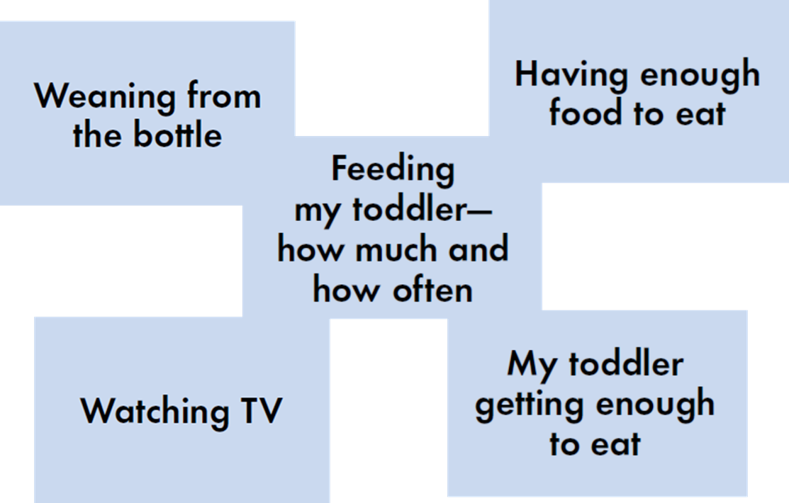
Card Sort & Your List
Notes:
The card sort and your list are two ways to identify challenges and concerns for parents so they can be addressed in the nutrition appointment.
Each of these tools include common topics and are separated by the participant’s category.

Slide 13
Card Sort & Your List
Card Sort:
Ask the participant to quickly sort through the cards, grouping them into one of three piles: “things going well," “things going so-so" and “things going not so well." The sorting takes less than a minute. The nutritionist can quickly praise mom for “things going well”, then review the “items not going so well" pile, asking questions to determine which topics are of greatest interest or need, and focusing the conversation on those topics.
Your List:
The tool can be given by the Program Assistant to clients when they check into their WIC appointments or by nutrition staff during their nutrition appointments. Clients are asked to identify topics of interest or concern. There are also places for them to identify unique concerns that aren't on the list.
Notes:
I am going to give examples of how these tools are used during an appointment.
Here is a quote of a story from a nutritionist. It provides her experience using the card sort.
“I saw her when she flipped through the cards, and she stopped on the way, and she
pulled around and said, ’You know, I never really said anything…I know you guys
know…that I AM overweight, but... what can I do?’ I never wanted to talk about it,
and I felt like the card made her, stop her…And now that she saw them, the question
in the cards, she wasn’t afraid to actually tell me and say, ‘I am concerned.’”
Card sorting is a fun and effective way to assess what topics are of greatest interest to participants!
Like the Card Sort tool, the "What's on your list" tool is an effective, quick way for clients to identify interests and concerns.
The "What's on your list" tool can be given by the Program Assistant to clients when they check into their WIC appointments or by nutrition staff during their nutrition appointments. Clients are asked to identify topics of interest or concern. There are also places for them to identify unique concerns that aren't on the list. The Program Assistant is a clerical staff member who determines income eligibility and other non-nutritional eligibility, issues benefits and schedules appointments.

Slide 14
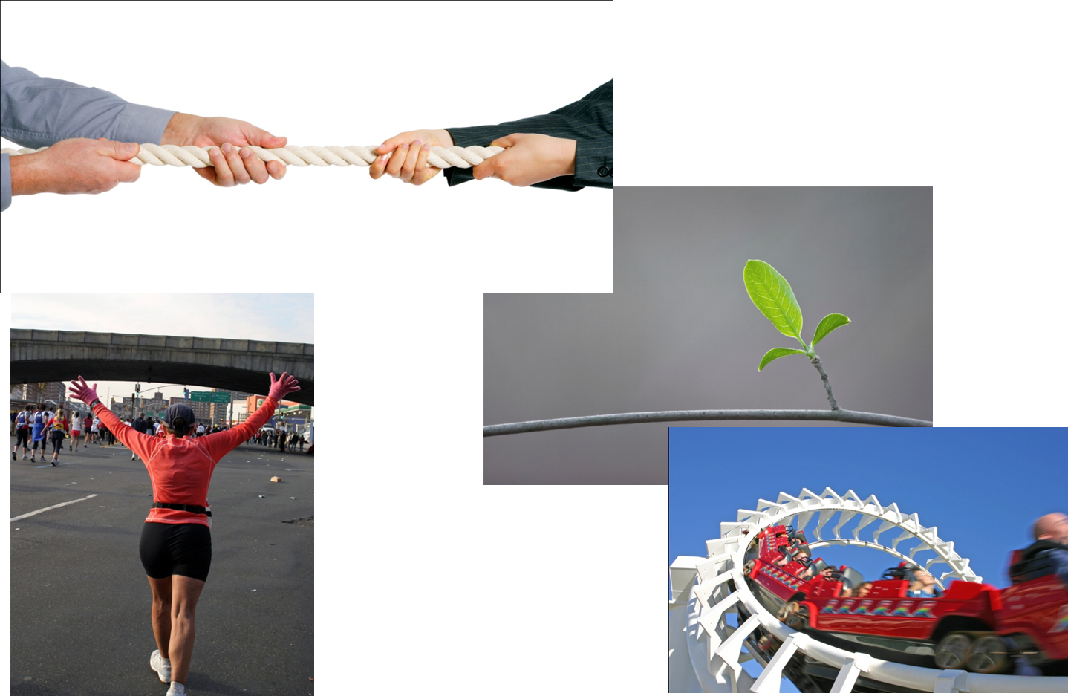
Metaphor Images
Notes:
The next two tools are image cards that uncover emotions and thoughts quickly.
There are about 20 photos for participants to choose from in the deck. Some photos represent positive emotions while other photos reveal negative feelings.

Slide 15
Metaphor Images
Place the metaphor images where the participant can see all of them.
Ask participant to select an image that says something about how they feel about a nutrition topic. (How their child is eating, weight gain during pregnancy, etc.)
Ask: "What does that image say about how you feel about (topic)?"
Use feelings as a springboard to an amazing conversation, wrapping suggested behavior change ideas in with emotions.
Notes:
I will give you an example of how the metaphor images are used in a nutrition session.
Allow nutrition staff to recognize concerns and successes using the metaphor image.

Slide 16
Doors
Notes:
The hopes and dreams doors are a tool that helps parents reveal their feelings and emotions.
Participants are able to share their thoughts and feelings which may be emotional drivers related to key behavior changes.

Slide 17
Doors
Lay out the "Hopes and Dreams Doors" so participants can easily see them.
Tell participants that these doors are special because they represent the hopes and dreams of all mothers (parents) around the world.
Ask participants to select a door that says something to them about their hopes and dreams (regarding health topics).
Ask client to "open the door" and share what's behind their hopes and dreams door for their children and family.
Listen carefully so you can connect the their feelings with nutrition-related behaviors. Use phrases like these:
Is there anything we could talk about today related to your child's eating that keeps you from feeling like the mom you always hoped you would be?
Notes:
I’ll give you an example of how the hopes and dreams doors are used in a nutrition appointment setting.
I’d like to share a story with you of a nutritionist’s experience using the doors.
“A nutritionist used the Doors with a new prenatal. The participant liked it so much that she brought her boyfriend back the next time to see the same nutritionist. When the nutritionist called the participant into her office, she requested that the nutritionist do the doors on her boyfriend. The boyfriend chose the door with the metal grate cover. When she asked why he chose this door, he said because he didn’t want his girlfriend to gain too much weight. This became a perfect opportunity to educate about weight gain requirements of having a healthy baby and how the weight is distributed over time. It ended up being a great appointment where the boyfriend left feeling good about her gaining weight.”

Slide 18
Magic Wand
Notes:
The magic wand is a fun, creative tool.

Slide 19
Magic Wand
The Magic Wand tool allows parents to step out of their daily realities and imagine magical powers. When they use this tool, you will be able to quickly identify change opportunities to discuss during their WIC visit.
Display the Magic Wand to the parents, telling the mom that the Magic Wand has the ability to transform everyday eating challenges. If she were to wave the wand, ask her to tell you about the eating challenges she would change first. Proceed to discuss "magical" actions the mother could take to transform her daily challenges.
Notes:
I’ll give you an example of how the wand is used in a nutrition appointment.
If a mother seems hesitant, you can use yourself as an example sharing your own desires to change something in your life that will allow the parent to be more open with her concerns.

Slide 20
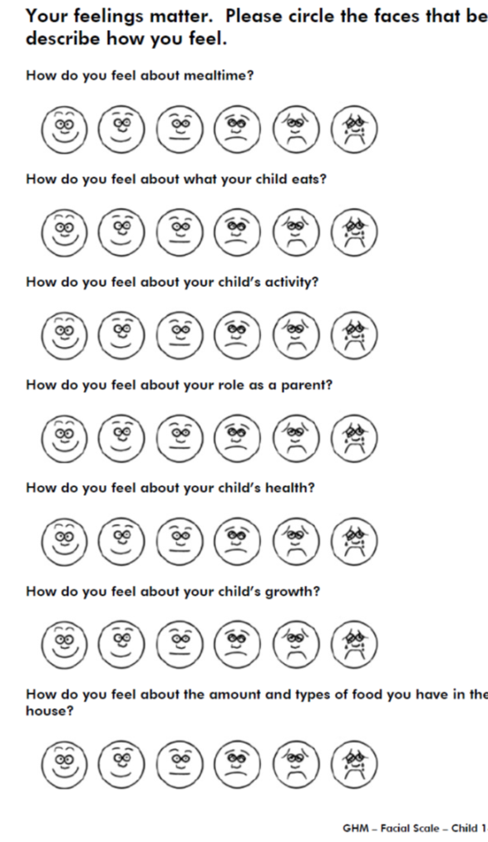
Hedonic Scale
A hedonic scale was introduced as another tool staff could use as a ‘jumping off point’.
Notes:
The last tool is the hedonic scale. It is a simple concept.

Slide 21
Hedonic Scale
The Hedonic Scale tool allows clients to quickly circle emotion-based faces that convey how they feel about a wide variety of topics, such as eating patterns, activity, health and growth. They also allow parents to suggest how they feel about more sensitive topics like food insecurity and their roles as parents.
Address positive responses first and recognize the successes.
Probe and ask questions like: “what could change to make your response a very happy face?”
Feeling Faces
Notes:
I’ll give you an example of how it’s used.
The nutritionist can address positive and negative responses.

Slide 22
Pilot Implementation Tips
It may not always be appropriate to use a tool
Documentation of what tools are used help reduce repetition
New tools keep the concept fresh
Start first with tools you feel most comfortable with
Frame it in a way that makes it obvious that you are talking about nutrition and health topics
Try starting with children re-certs.
Try ‘expert of the month or week’
Practice, practice, practice!
Notes:
It’s not always appropriate to use a tool. For an example, some nutritionists have already built the rapport in previous sessions and have a relationship with the participant. Therefore, tools aren’t necessary to break the ice.
It is important for nutrition staff to document somewhere in the care plan which tool was used. This will reduce repetition of using the same tool in multiple appointments.
Nutrition staff should start using the tool that they feel is the most comfortable tool for them. Then, use the other tools in the future.
Frame it in a way that makes it obvious you are talking about nutrition. For example, “what does meal time look like in your home?”
Try starting with child re-certifications to make the appointments new and exciting.
Try an ‘expert of the month’ where each nutritionist becomes familiar with one tool then reports findings with each other at a staff meeting.
Practice to increase comfort level.

Slide 23
Getting to the Heart of the Matter Pilot Results
Focus groups and surveys reveal that participants love WIC
“I’m more looking forward to see the nutritionist, because I’m waiting for... to hear, ‘Oh, there’s been changes. Oh, your son is growin’, it seems like he’s gaining weight.’ And she seems to acknowledge, because... she’s relating to me…she was able to visually and written, connect with my issues with my son. I’m looking forward to seeing her, because I know that I I’m gonna get some feedback, positive feedback, or if there’s some concerns, she’ll let me know how to address them. And before, I never cared.”
Notes:
I will share this quote to give you an overall feeling of how participants and staff received the Getting to the Heart of the Matter project.

Slide 24
GHM Evaluation: Summary
Surveys: >95% of pre-test responses were positive for staff and participants at intervention and control sites
Maintained in post-test surveys
Could reflect other MA WIC Program activities in study period:
THTM, VENA, Food package changes
Qualitative findings
Participants: Importance of ongoing relationship with nutritionist and continuity of information in communicating concerns and following nutrition advice
WIC staff: GHM tools and techniques increase participants’ confidence, comfort and satisfaction; change structure and content of counseling; increase staff connection with clients. Training and feedback essential.
Notes:
We had a challenge (albeit a positive one) in the quantitative evaluation of the project because we had very high satisfaction responses in both the pilot and control sites before the pilot began. There was not too much room for improvement in many of survey sections. This could reflect the many exciting things that were also happening within WIC at this time.
However, we did see through our qualitative evaluation that the Getting to the Heart of the Matter project had made a positive impact.

Slide 25
Post-Pilot Ethnographic Research
Less reliance on computers during assessment
Positive changes in body language
Balance of control of the conversation between educator and client
Counseling and assessment more informal and relaxed
Clients sharing more concerns and questions
Some clinic environment changes
More positive and warmer customer service
Eye contact between the educator and client made the conversation more relaxed and enjoyable
Clients value nutrition information provided during WIC counseling sessions; WIC educators may have a limited perception of their potential influence with clients
Notes:
We were very pleased with the observations conducted during the post-pilot ethnographic research.
Clients said, “WIC educators were kind, friendly, and caring. Clients perceived educators’ current actions to be sincere.”
Clients at most sites said they would come for the nutrition education alone. They welcomed the opportunity to talk face-to-face even if they already knew and understood the information.

Slide 26
Lessons Learned
GHM provides tools to move staff towards VENA, but does not stand alone; Constant support, mentoring and training is needed to create and sustain change
Staff and participants approach new concepts with varied levels of comfort and willingness to experiment; techniques need to be attempted multiple times to determine success
Identifying a champion in each local agency is key
New tools can become old over time; need for continual introduction of new elements
Open conversation can be overwhelming for staff, especially when sensitive topics outside of nutrition expertise are raised
Notes:
We learned several lessons as a result of our pilot project.
One important finding was that VENA, especially enhanced by the tools that invited open ended responses, allowed participants to share many challenges in their lives, not just the nutrition-related ones. Staff often felt that they were acting as nutritionists and social workers, and that they weren’t trained for that. They also felt burdened by the new knowledge they had about participants lives and their limited ability to follow-through with the referrals they provided to the family once they left the clinic.
This finding led us to apply for a third Special Project Grant, which has allowed us to evaluate the effectiveness of part-time Family Support Coordinators (FSCs) in 10 pilot clinics in Massachusetts. The FSCs help ensure that families can connect to the referrals provided to them by nutrition staff, allowing the families to better meet their needs and to come to WIC in future appointments better positioned to make nutrition-related behavior changes. The project is also evaluating whether the clinics that have FSCs have better retention of children in WIC.

Slide 27
Getting to the Heart of the Matter
Local Program Perspective
Notes:
Getting to the heart of the matter has been a positive new way to approach patients. The tools we used in the past were very standardized and patients were clearly giving answers they thought we (nutritionists) wanted to hear. After the implementation of getting to the heart of the matter patients were opening up more during appointments and we were seeing positive health outcomes. GHM really focuses on having the participants share their true feelings and this allows us (the nutritionists) tailor each appointment to really help meet the needs of the participant.
In order for all Nutrition staff to feel comfortable with GHM tools our Senior Nutritionist had us role play at nutrition meetings. Along with that, staff sat in each other’s appointments and observed coworkers using GHM tools with patients. Role playing and observing appointments really allowed all nutrition staff to become comfortable with using all the different tools that GHM has to offer.
Getting to the Heart of the Matter tools that I utilize often are the metaphor images. To use the metaphor images I asked a participant ‘What image would you choose that best shows how you are feelings about your child using the bottle?” The mom chose the ball and chain image and explained to me why. The next time this patient came into the WIC office she immediately pointed to the image with the woman in red with her hands up in the air. She had success stopping the bottle! Getting to the heart of the matter really allows nutritionists to form bonds with patients and create trust that was missing before.
Along with nutrition staff using GHM tools our Program Assistants give out the baby books to pregnant mother’s and say ‘this Baby Book is a gift for you and your baby’. The baby book can be a really positive way to get mother’s to open up. I had a first time mother who was apprehensive regarding her pregnancy. Together we looked over the baby book and I could see just by asking the first question ‘Here is what I am eating so you be strong’ really changed the way mom was feeling about the pregnancy. After having the baby this mother brought in the baby book filled with pictures and explanations on what she did throughout the pregnancy to stay healthy. Again this mother was able to open up and share with the WIC nutritionist. GHM has participants wanting to come back and share with us the successes they have had at home.

Slide 28
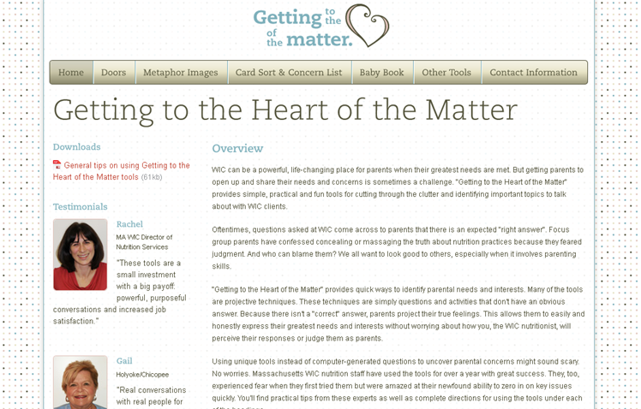
Training Website
Created an on-line version of all project products to be distributed and shared on www.gettingtotheheartofthematter.com
Includes an overview of the emotion-based services, guidance for implementation, training tools and printable versions of materials or order information.
Provides on-going support
Notes:
You can access a lot of information about the project at the website posted here. If you are interested in getting the tools in languages other than English, please contact Lynn Beattie. Her contact information is provided at the end of this presentation.

Slide 29
Getting to the Heart of the Matter Moving Forward
Getting to the Heart of the Matter/Counseling Task Force meets quarterly for technical assistance on the tools and techniques.
Task force members play a vital role in creating new tools to keep the concept fresh. These tools are field tested with participants and adapted before development for all local programs.
Task force discusses other counseling topics that are relevant and pertinent to the on-going support of VENA.
Notes:
The state office has provided on-going training, technical assistance, support, and new concepts have been offered to continue the VENA journey and making the WIC office a place for powerful behavior changes.

Slide 30
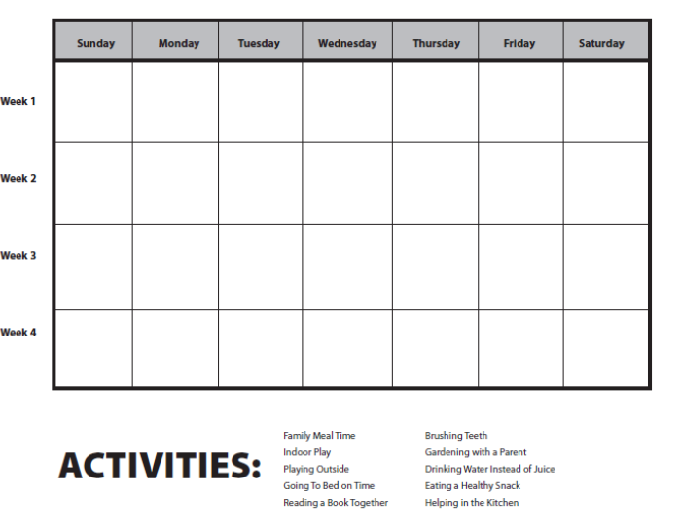
Getting to the Heart of the Matter New Tool
The Activities Photos and Calendar tool is used to identify what types of healthy activities parents are currently doing with their children and what new actions they would like to try to add to their lifestyle. After choosing an activity, parents are given a calendar. Each time they are able to do the activity (going to park for physical activity, eating together as a family, etc.), the child can put the sticker on the calendar to keep track and feel proud of their accomplishments each week.
Notes:
We’d like to share our newest tool that was developed by the Getting to the Heart of the Matter Taskforce.
Nutritionists have several photos on a ring that display families doing healthy activities such as family meal time, outdoor activities, going to bed on time, etc. The parent flips through the photos with their child and chooses an activity that they would like to work on. The tool allows parents to choose their focus point and action plan.

Slide 31
VENA after Getting to the Heart of the Matter
After roll out, on-going refresher trainings have been offered on VENA concepts on a regular basis.
All Touching Hearts, Touching Minds and Getting to the Heart of the Matter content has been integrated into new staff training for new nutrition staff and paraprofessionals.
Various task forces work together to keep nutrition education materials and tools fresh and emotion-based.
Counseling, nutrition assessment and documentation trainings are offered to ensure comfort with nutrition service standards.
Group education trainings are offered to train staff on facilitating successful groups for WIC parents.
Notes:
We continue to work on enhancing nutrition assessment and participant-centered nutrition counseling skills in a variety of ways with our staff.

Slide 32
VENA Training Strategies
Painting a Picture- OARS Brings a Picture to Life
Notes:
We’d like to share how we train on VENA. The next several slides display how training is presented.
We look at VENA and the elements of an appointment abstractly. VENA can be looked at like painting a picture. Each brushstroke helps to complete the picture, just as each bit of information that we retrieve from a participant gets us closer to understanding the participant. And being better able to help him or her.
A piece of art—it takes work—its finding the subject to paint, the colors that make up the piece, the background, the details. In an appointment, there is the prep-work of building rapport and connecting with a participant. Sometimes you need to probe for more information, ask open-ended questions, use reflective listening and finally summarize at the end.

Slide 33
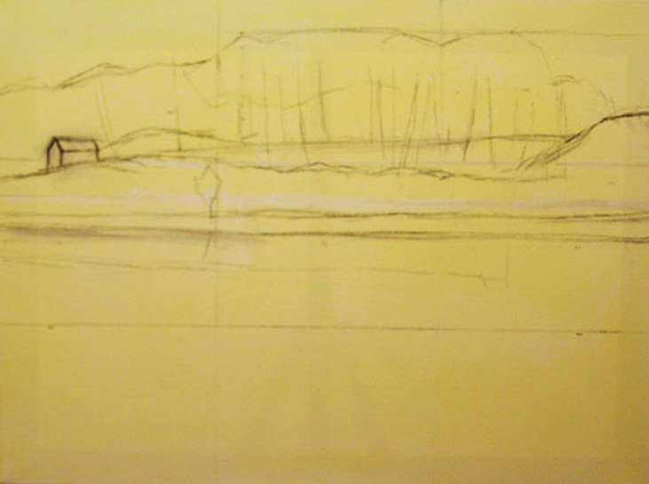
VENA Training Strategies
The First Stroke
In order to get someone to listen and take your advice you must:
Establish a relationship.
Build trust.
Connect.
Think about:
How participants are greeted
Clinic environment
Phone contact
Screening charts/ previous plan
Notes:
We train staff to think a lot about first impressions before they think about the nuts and bolts of the nutrition assessment and counseling.

Slide 34
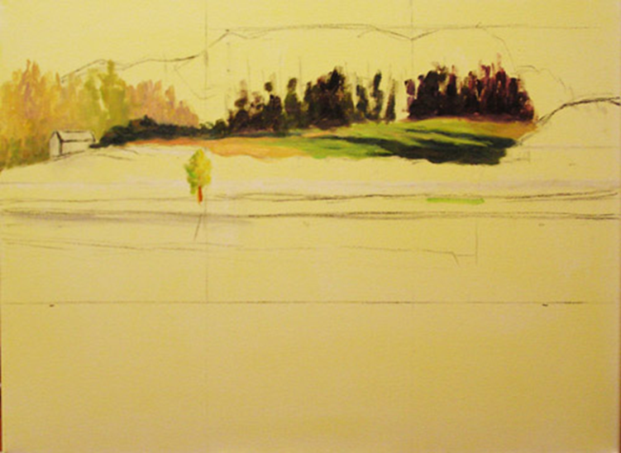
VENA Training Strategies
Using Open Ended Questions/Individualized Conversation
If we use the diet questionnaire the same way each time and try to complete it much like a checklist, we will miss some valuable information and its purpose gets lost.
Participants’ Perspectives on the Old Way
“That’s how they get I think the packages,
you know, that they give on the checks.”
“They ask just to see if the food they’ve been providing
—if she eats it— if there is any way to make it better.”
Notes:
The next few strokes are using open-ended questions and individualizing the conversation (participant-led discussion).

Slide 35
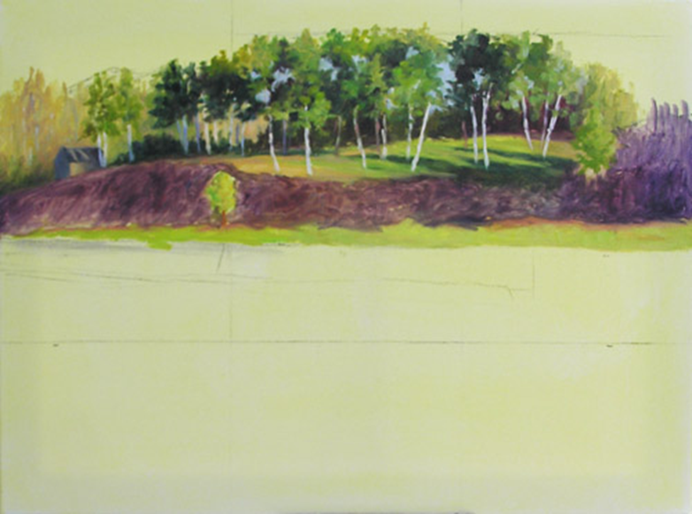
VENA Training Strategies
Affirmation
Notes:
The next step is praising the parent and providing affirmation.

Slide 36
VENA Training Strategies
Reflective Listening
Notes:
As you can see in the picture, there is now a reflection in the water. It is important for nutrition staff to reflect back what they heard the participant say.

Slide 37
VENA Training Strategies
Summarizing
Notes:
Summarizing at the end of the appointment is an important part of the session. It makes the next steps clear for both the nutritionist and participant.

Slide 38
VENA Training Strategies
What is a complete assessment?
One that not only gathers all of the necessary information in the nutrition session, but flows and encourages someone want to take action towards a healthy behavior change
The next step should be obvious to the nutrition educator and participant
Notes:
We share this vision of a complete assessment with staff.

Slide 39
Bringing VENA Back to the Clinic
Explore options to juggle VENA with Eos (WIC MIS) requirements
Notebook
Asking critical questions after a rapport has been built or during other routine data collection
Turn computer and involve participant in data collection
Focus on the interaction/conversation
Be okay with silence
Don’t focus on looking for a problem—focus on what is important to the participant
Listen more, talk less
Relax and enjoy the appointment
Notes:
Integrating VENA with our WIC MIS system has been a challenge. We’ve explored different options of capturing the discussion between the nutritionist and the participant so that the computer doesn’t get in the way of an emotion-based, individualized conversation. Here are some examples that have worked in local programs.
Staff have also received the advice above in the transition to a more VENA oriented appointment.

Slide 40
VENA and the Management Evaluation
Dietary intake is adequately collected and assessed using VENA techniques.
Nutrition counseling and information is appropriate for participant’s needs, interests and risk.
Counselor utilizes nutrition education materials and tools appropriately, giving consideration to the participant’s culture, literacy level, and language.
Nutrition counseling is individualized and participant-led; nutrition staff uses emotion-based/VENA techniques to provide nutrition education, set goals (focus points), and summarize the counseling appropriately.
Notes:
Since the launch of our Touching Hearts, Touching Minds project and the VENA initiative, we have made efforts to incorporate VENA concepts into our management evaluation. These are the standards we currently assess for compliance when we perform chart reviews and conduct observations.
We have also tried to incorporate components of VENA (open-ended questions, affirmation, etc.) into our management evaluation process both in information gathering and in providing feedback to local agencies.

Slide 41
Components of a Complete VENA Nutrition Assessment
Conveys a good overall picture of dietary intake, including typical consumption patterns from the five food groups
Collected using open-ended questions, affirmations, reflective listening and summarization
Identifies concerns raised by participant
Identifies positive components of participant’s diet, as well as concerns of nutrition staff
Provides reasoning for assigned dietary risks
Documented in the diet questionnaire or the Subjective portion of the Care Plan
Provides sufficient information for other nutrition staff to provide follow-up care
Notes:
The Eos Diet Questionnaire is a screen in our MIS system that asks questions about appetite, food behaviors and consumption of various food groups. Certain responses can allow for automatic assignment of nutritional risk. None of the questions are mandatory. The Questionnaire is mostly an artifact of the transfer MIS system and needs to be updated to better encompass VENA principles.
Staff may utilize the Eos Diet Questionnaires to guide and document the nutrition assessment. These questionnaires are not intended to be used as a script; instead, the VENA assessment should be conversational and participant-centered, using the questionnaires as a framework from which to proceed and as a repository for diet assessment data collected.
If the Diet Questionnaire is not used at the certification appointment to document the diet assessment, the nutrition assessment information in the Care Plan/SOAP note must be thorough enough to satisfy the components of a complete assessment as described above.

Slide 42
Challenges
Documentation
MIS system flexibility/requirements
Uncovering sensitive issues
Expectations of paraprofessionals
Notes:
While we have come a long way in WIC nutrition assessment and counseling, we continue to face several challenges.
Staff often face time or technological constraints that make the documentation of a participant’s dietary patterns and diet assessment more challenging than the actual provision of the service. Part of the problem is that our WIC software was designed before we had a full grasp on the complexities of the VENA process and the best ways to support staff in the documentation. Updates will need to be made to the system to better capture this information.
As mentioned previously, we were not prepared for the discomfort nutrition staff would feel as they uncovered more sensitive information from participants as a result of the VENA process. Our Family Support Coordinator project, along with additional training and support for nutrition staff, will help to address this concern.
Lastly, it has been somewhat challenging to implement a less structured system of collecting and documenting dietary intake and nutrition assessment with our paraprofessional staff. Many of them were trained using our old food frequency questionnaires and a regimented process for providing nutrition education on the findings of that assessment. Paraprofessional staff offer the program language skills, help the staff better reflect the composition of the community and provide the local agency with more flexibility in staffing the clinic. However, without having the professional background in nutrition, we have had to provide several additional trainings to our paraprofessional staff to better prepare them to conduct a thorough nutrition assessment.

Slide 43
VENA in MA Now
Local Program Perspective
Notes:
VENA has also been a very positive new way to approach participants. When VENA first rolled out it was difficult for staff to feel comfortable using open ended questions. Again, our Senior Nutritionist helped make the transition easier for us. Once more we role played at nutrition meetings and created cheat sheets which included open ended questions that could easily be used in appointments and we posted these in our offices. Along with changes to our counseling style we needed to type a more detailed care plan. Another cheat sheet was created to help us decipher what type of information needed to be included in our care plans. Both role playing and cheat sheets were extremely helpful with the implementation of VENA.
Recently, a family I have seen on numerous occasions came in for their WIC appointment. Immediately the father started talking about his concerns for his daughter. At a recent doctor’s appointment they were told their daughter is at risk for hypertension. The family was confused as to why this was happening to her since it has never been an issue for anyone else in the family. Using the techniques I learned through VENA I was able to listen to the concerns of the family. I used open ended questions and found out food preparation and lack of exercise were contributing factors to the child’s high blood pressure. The parents came up with a plan they would follow immediately. I was able to send them home with information regarding hypertension and different handouts with healthy recipes and activity ideas. This appointment was tailored to the specific needs of the child. It wasn’t necessary for me to use GHM during this appointment since the patient opened up immediately. VENA and Getting to the Heart of the Matter changed the way patients view coming to the WIC office. Nutritionists and participants are able to connect and the trust participants have in the Nutritionists created a much more positive atmosphere.

Slide 44
MA WIC Contacts & Resources
Rachel Colchamiro
rachel.colchamiro@state.ma.us or 617-624-6153
Lynn Beattie
lynn.beattie@state.ma.us or 617-624-6158
Corey Greene
crgreene@mgh.harvard.edu
www.touchingheartstouchingminds.com
www.gettingtotheheartofthematter.com
www.mass.gov/wic
Notes:
Here is our contact information and the websites for our projects and our WIC Program. Please note that we will be transitioning the Touching Hearts, Touching Minds materials to the WIC Works Resource System in the near future and will likely do the same for the Getting to the Heart of the Matter materials.

Slide 45
Additional Questions
If you have additional questions about the Massachusetts VENA project, please contact:
Lynn Beattie, MPH, LDN, CLC
Lynn.beattie@state.ma.us or 617-624-6158
If you have questions about VENA in general please contact your respective FNS Regional office.
Notes:
Lynn is the point of contact for requests for printer files associated with these projects.

Slide 46
Thank you!
Thank you for your participation.
Thank you for your hard work.
Stay tuned for the next webinar.
Notes:
Thank you for joining us on today’s webinar. Also, thank you for your hard work.
Please stay tuned for the date and topic of the next webinar.

