Slide 1
Wednesday, January 28, 2015
2:00-3:00 PM ET
Audience: All WIC Agencies
Notes:
Welcome and thank you for participating in the Value Enhanced Nutrition Assessment (VENA) webinar. My name is Donna Hines, I am Chief of the Policy Branch at the Food and Nutrition Service (FNS), National WIC Office. FNS is pleased to present this series of webinars with the purpose of revitalizing VENA and to assist State and local agencies in their continued implementation of VENA.

Slide 2
Equipping Paraprofessional Staff
To Deliver VENA
Notes:
We are pleased to host today’s webinar: Equipping Paraprofessional Staff to Deliver VENA, presented by Lynn Ireland and Brigitte Boyd of the CO WIC Program. I’ll now turn it over to Lynn Ireland.

Slide 3
Presenters
From the Colorado WIC Program:
1. Interpreting and Implementing VENA
Lynn Ireland, MS, RD
Nutrition Coordinator
2. Keeping VENA Alive and Thriving
Brigitte Boyd, RD
Nutrition Consultant
Notes:
Thanks you Donna.
I am Lynn Ireland, CO WIC Nutrition Coordinator. My presentation, titled “Interpreting and Implementing VENA” covers how the CO WIC Program tailored FNS’ VENA guidance for our CO local agency paraprofessional and professional staff.
Brigitte Boyd, CO WIC Nutrition Consultant, will then present CO WIC’s training programs in more detail during her presentation, “Keeping VENA Alive and Thriving”
(Next slide)

Slide 4
Interpreting and implementing VENA
Lynn Ireland
Notes:
Interpreting and implementing VENA
My presentation describes:
CO WIC staffing model
Interpreting VENA guidance for our local staff;
VENA-related approaches that survived the test of time and;
Ways we continue to incorporate VENA into everyday activities
(next slide)

Slide 5
Colorado WIC Program
Caseload:
92,000 participants (monthly average)
WIC Local Agencies: 38
WIC Clinics: 94
State Office Staffing:
Total number: 22
Nutritionists: 5
Notes:
To give you an idea of our size:
CO WIC serves an average of 92,000 participants each month.
The state contracts with 38 local agencies, who operate a total of 94 WIC clinics.
22 people work at the CO WIC State Office. Five Nutritionists comprise the State Office Nutrition Unit.
(next slide)

Slide 6
Two primary levels of staff: Two types of Local Agency WIC staff:
WIC Educator / paraprofessional
Total number: 241 (2/3)
Qualification: GED
WIC High Risk Counselor/professional
Total number: 124 (1/3)
Qualification: RD, RN, BSN, MD, or PA
Notes:
There are two general types of local agency WIC staff: Paraprofessionals (or WIC Educators) and Professionals (WIC High Risk Counselors)
2/3 of the all staff employed by local agencies are paraprofessionals and 1/3 are professionals.
The minimum qualification for a WIC Educator is a GED. WIC High Risk Counselors can possess any one of a variety of credentials.
Because many local agency staff are hired with little or no formal nutrition training, State Office maintains a robust new employee orientation platform and offers ongoing staff training opportunities.

Slide 7
Certified WIC Authority
To become a CWA, the local staff person:
Scores 90% or greater on all Level I modules;
Passes WIC computer system training;
Demonstrates competency through a formalized evaluation of a participant visit and record review.
Notes:
Most states use CPA or Competent Professional Authority to describe the local staff person who is qualified to determine eligibility and issue food benefits. In Colorado, we use the term Certified WIC Authority (or CWA).
Both paraprofessionals and professionals can become a CWA, after successfully completing a rigorous competency-based training program. While they are in training, other experienced CWAs in that local agency provide extensive oversight.
Read slide
Brigitte will provide more detail about our new employee training program in her presentation.
(Next slide)

Slide 8
Certified WIC Authority
WIC Educator
Certified WIC Authority (CWA)
Determines eligibility
Assigns nutrition risk factors
Low Risk High Risk – refers to WIC High Risk Counselor
Provides low risk nutrition education
Issues food benefits
Notes:
Once the WIC Educator passes all the requirements and qualifies as a CWA, she performs all these duties during a certification/recertification visit –
Determines eligibility
Performs nutrition assessment and assigns nutrition risk factors (or NRFs)
Provides “low risk” nutrition education
Issues food benefits
As you know, each WIC state agency designates which nutrition risk factors are low risk and which are high risk. Generally speaking, Colorado designates NRFs as low risk when the education or counseling around that NRF can be performed by a trained paraprofessional. Low risk NRFs in Colorado are, for example,
dietary-related NRFs,
borderline low hemoglobin
“had a specific complication during a previous pregnancy.”
Colorado considers NRFs high risk when a health outcome could be affected and counseling from a person with clinical expertise is needed. Examples of high risk NRFs are:
Most medical conditions;
Growth-related situations;
Very low hemoglobin

Slide 9
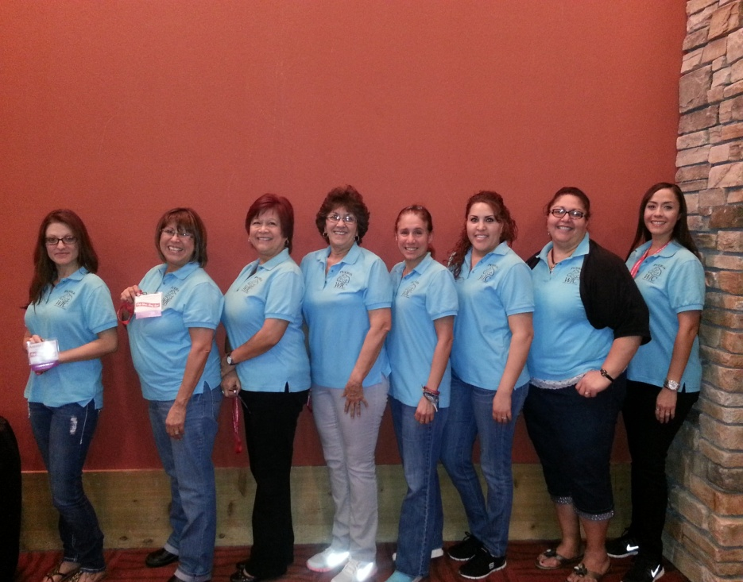
Advantages of the paraprofessional staffing model
Cost-effective
Peer support
Bi-lingual
capabilities
Cultural Competence
Pueblo WIC Staff
Notes:
Besides cost-related advantages, paraprofessionals bring significant value to the WIC Program and to participant’s WIC experience. They easily understand the participant’s perspective. Participants feel more at ease and are more apt to confide in someone of a similar cultural background – and thus be successful at a core tenant of VENA – that of building rapport and fostering open communication.
Here is a photo of our fabulous WIC staff from Pueblo, Colorado.

Slide 10
Interpreting FNS VENA Guidance
Collaborative Planning –
Summer 2006 – Spring 2008
Local Agency and State WIC VENA Advisory Group
Coined the term “Participant-Centered Care” (PCC) instead of “VENA”
Training consultants
Notes:
Once FNS published the VENA Guidance, Colorado began a 2-year process to interpret and implement VENA in our local agencies.
Our first step was to convene the VENA Advisory Group, comprised of state staff and local agency staff with various positions, from various sized-agencies and geographical locations. This Advisory Group provided guidance every step of the way. For example, the Advisory Group decided that the phrase, “Participant-Centered Care” (or PCC) should be our term for VENA because we thought PCC simply described the VENA initiative.
Additionally, they were key consultants while State Office developed the guidance and tools for statewide implementation.
For listeners on this webinar who are not familiar with FNS’s VENA guidance, you can find it on USDA’s WIC Works Resource System.

Slide 11
Our Mission
Ensure local agency staff have the tools and guidance in order to establish trust and maintain credibility with participants in order to affect positive behavior change.
Notes:
In a nutshell, the VENA Advisory Group’s mission was to:
Ensure local agency staff had the tools and guidance in order to establish trust and maintain credibility with participants in order to affect positive behavior change.

Slide 12
PCC Implementation
Effective counseling approaches
Improved subject matter expertise
Evaluation method to measure performance when delivering PCC
Notes:
To assist locals in implementing Participant Centered Care, State Office created tools and guidance around:
Effective counseling approaches
Improving subject matter expertise
Evaluation method to measure level of performance when delivering PCC
So….from this effort, I’d like to share some things we learned or developed that you may find useful to your work:
First, Concepts that survived the test of time
Second, how our WIC computer system design supports VENA
Last, an Evaluation Form to measure the level of success in practicing PCC principles during a WIC visit

Slide 13
Concepts that Survived the Test of Time
During the WIC visit:
Linking Assessment to Nutrition Education/Counseling
Putting the puzzle pieces together
Notes:
One concept that survived the test of time centers around how to link the nutrition assessment with counseling.
The nutrition assessment involves entering measurement values and asking many open-ended questions. Staff listen carefully to the answers and look for misinformation, information gaps, and expressed concerns. When we hear something concerning, we pose additional questions to probe deeper, to better understand the issue. By the time the assessment is complete, a lot of information has been collected.
We’ve learned that knowing the right questions to ask and the right topics to cover is a skill that develops over time with increasing knowledge and experience.
We also learned that it helps to keep track of the most important topics identified during the assessment.

Slide 14
Assessment ➔ Counseling
Dealing with all this information and deciding what to talk about:
Prioritize the information
by identifying areas of most concern and of most interest to the participant
Notes:
So how does one organize all the assessment information in order to deliver counseling that is relevant to the participant?
The first step is to prioritize the information. This means:
The staff person identifies those topics that are most important (or have serious consequences) AND those of most interest to the participant.

Slide 15
Assessment ➔ Counseling
2. Negotiate the agenda together:
Ask if participant has questions or concerns
Choose 1-2 topics to discuss at this visit
Affirm/ask permission to discuss topics you think should be discussed
Notes:
The second step is to negotiate the agenda together with the participant:
Ask if the participant has questions or concerns
Choose 1-2 topics to discuss at this visit.
Affirm/ask permission to discuss topics you hope to discuss

Slide 16
Assessment ➔ Counseling
3. Document other topics for a future visit
4. Refer participant to the WIC High Risk Counselor when warranted
Notes:
3. Document other topics for a future visit in the participant’s record;
4. Refer participant to the WIC High Risk Counselor when warranted

Slide 17
Nutrition Education / Counseling
Pointers when providing education:
Dialogue: talk “with”, not “at”
Connect from something said during assessment
Find out what the participant already knows about a topic and fill in the gaps
Personalize learning (exp: handouts)
Be non-judgmental and affirming
Notes:
Here are some ideas that survived the test of time when providing nutrition education:
Use a conversational format style--don’t just tell them things; get their response as you go along.
Begin by finding out what the person already knows about a topic so that you don’t bore them with unnecessary information. Most people know a lot more than they actually put into practice. If knowledge is not an issue, consider shifting gears to talk about changing behaviors instead of giving more information.
People have different learning styles-some people learn by hearing, some by seeing and some by doing. For this reason, it is helpful to use visual materials such as handouts and posters while you talk. Writing on handouts can help personalize them.
And most important: Never stray from being neutral - not judgmental. And always be on the lookout for opportunities to affirm

Slide 18
Incorporating VENA into MIS System Design
Concurrent to launching PCC, CO was designing our new WIC MIS system, together with WY, UT, USDA and Ciber – MPSC system
Goal: Create a computer system that promotes dialogue exchange between WIC staff and participant – (not one that drives the visit)
Notes:
At the same time we were interpreting PCC, CO, WY, UT, USDA and Ciber were designing a new WIC MIS system. This system is known as the MPSC system (Mountain Plains States Consortium) system.
Our collective goal was to create a computer system that promotes dialogue exchange between WIC staff and participant – (not one that drives the visit)

Slide 19
Incorporating VENA in MIS System Design
Created a Nutrition Interview for:
Pregnant
Postpartum
Breastfeeding
Not Breastfeeding
Infants
Breastfeeding
Non-breastfeeding
Children
Notes:
Incorporating VENA in MIS System Design
Created a Nutrition Interview for:
Pregnant
Postpartum
Breastfeeding
Not Breastfeeding
Infants
Breastfeeding
Non-breastfeeding
Children

Slide 20
Incorporating VENA in MIS System Design
The Nutrition Interview includes components specific to that participant category.
Child Interview:
Health/Medical
Immunizations
Oral Health
Lifestyle
Nutrition Practices
Social Environment
Notes:
The Nutrition Interview includes components specific to that participant category.
Child Interview:
Health/Medical
Immunizations
Oral Health
Lifestyle
Nutrition Practices
Social Environment

Slide 21
Notes:
Here’s how the system supports a participant-driven visit:
This particular screen is a snapshot of a small portion of the nutrition assessment of a child. Note the Nutrition Interview located in the center of the screen.
Should the conversation quickly change to another subject area, the user can click on any of the general topics listed to the left of the Nutrition Interview questions.
Located on the left margin of the screen is the navigation tree of the Clinic Services functional area. The first part pertains to eligibility, then assessment, certification/termination, education and foods. Nutrition Interview is highlighted because that’s the screen we’re on.
WIC staff can also navigate to any of these areas during the WIC visit.
The Nutrition Interview is comprised of general questions along with supporting bullets to help the user listen and assess for other areas that might merit focus.
Note the text box to the right. Staff enter participant responses into the text box, which then the system automatically populates into the “Client Comments” portion of the Participant Care Plan.
The “Starters/Prompts” text box at the bottom of the screen is a where SO can add reminders or reinforce trainings to further support the local user.

Slide 22
Child Nutrition Interview
Notes:
Here’s a screen shot of a portion of the Medical Conditions portion of the Nutrition Interview. Note the many check boxes, 347 – Cancer, 348, etc. where the user can assign nutrition risk factors.

Slide 23
Assessment and Counseling Evaluation
An evaluation form used to evaluate how well a staff person practices Participant Centered Care.
Can be used person to person, for new employee training, and for employee performance evaluations
Is available on the CO WIC Program web site
Notes:
The next slide displays the a portion of the WIC Visit Assessment and Counseling Evaluation Tool.
This tool can be used used to evaluate how well a staff person uses Participant Centered Care concepts.
This form can be used person to person as a refresher, for new employee training, or for employee performance evaluations.
This form is available on the CO WIC Program web site

Slide 24
Notes:
Here is the first half of the form
The form is divided into the following sections:
Work space
Participant Greeting
WIC Program Initial Explanation
Nutrition Assessment
Nutrition Education
Referrals
Behavior Change
Goal Setting
Interviewer behaviors

Slide 25
Ongoing PCC-related Activities
Update Program Monitoring criteria
Colorado WIC News (WIC LA Newsletter)
Participant Satisfaction Survey
Local Agency Nutrition Education Plans
Notes:
There are many ways CO WIC continues to keep PCC concepts alive such as:
Periodic revisions to the Program Monitoring process;
Publish articles in the Colorado WIC News, our local agency newsletter, to share local agency successes and innovative ideas;
Use feedback gained from the CO WIC Program’s Participant Satisfaction Survey to identify areas for improvement;
Use the Local Agency Nutrition Education planning process
However, staff training is the primary way we keep VENA alive and thriving. Now I’m turning the presentation over to Brigitte Boyd, CO WIC Nutrition Consultant, who coordinates the training State Office provides for local WIC agency staff.

Slide 26
Keeping VENA Alive and Thriving
Brigitte Boyd, RD
Notes:
As Lynn said my name is Brigitte Boyd, I will be discussing our continued effort to implement VENA and also briefly touch upon our new employee training

Slide 27
Using Appreciative Inquiry to Improve WIC Participant Engagement and Confidence
Keeping VENA Alive and Thriving
Notes:
In the on-going process to allow for continued improvement it was determined that a refreshed way to look at delivery of nutrition services and provide additional skills would be of benefit. This lead Colorado to a concept called AI, which is a counseling technique that is a compliment to the skills and knowledge paraprofessional staff already possess.

Slide 28
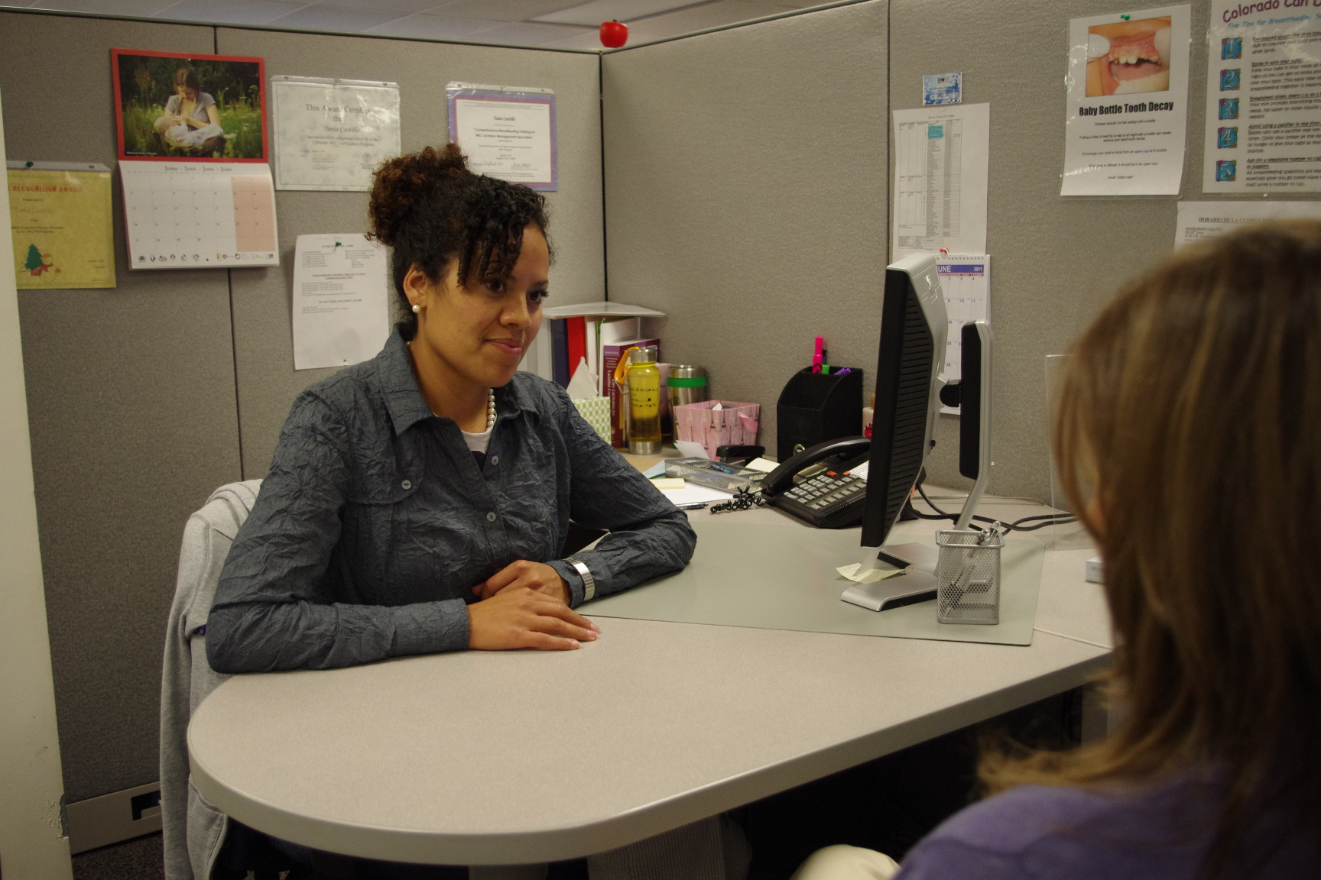
Appreciative Inquiry
Training conducted in 2013:
Simplify Motivational Interviewing techniques for the WIC environment
Boost participant confidence
Effectively engage participants
Notes:
In 2013, we were fortunate to work with a local trainer, by the name of Nora Lynch. Nora worked in the Colorado WIC Program as a high risk counselor and received certification as a Wellness Coach. During her career with WIC she used her training as a Wellness Coach to fine tune and develop Appreciative Inquiry techniques for the WIC setting. She found this technique successful and wanted to share it.
One way to describe Appreciative Inquiry is Motivational Interviewing’s step-sister. What that means is Appreciative Inquiry uses the spirit of MI with an emphasis on boosting participant’s confidence, or self- efficacy, so families believe they can be successful at change.
Regardless of the counseling method used, a characteristic that has been shown to be effective in changing behavior is interaction that engages the participant.

Slide 29
Appreciative Inquiry
A conversational approach that focuses on acknowledging successes and determining desired changes so participants can:
Feel more confident and energized by focusing on what is going well
Connect actions to health outcomes
Be more likely to be successful with behavior change
Notes:
AI is a conversational approach that centers on framing questions around positive feelings by focusing on what is going well in the present, past, or what the family wants for the future related to health and nutrition behaviors. This re-directs the assessment gathering away from deficiencies, or what the family is doing wrong and instead builds families up by acknowledging their strengths. It invites staff to link a participant’s action with a positive health outcome and more importantly positive feelings. In addition, it also sets the stage for a participant centered visit.
Creating this warm dialogue helps engage participants to get them talking about what matters to them and to help staff understand their situation. In other words, getting participants talking helps staff gather the information needed to determine the best direction of the nutrition education.

Slide 30
Appreciative Inquiry
Appreciative Inquiry (AI)
Ask an AI question
Look or scout for positive feelings
Pause
Affirm to Amplify the Feeling
Further Assessment/Nutrition Education
Notes:
In order to provide a springboard for staff to begin using AI it was summarized into 5 simple quick steps. First…
Ask an AI question, Remember this is a question about health or nutrition behaviors framed around positive feelings, for example. “Tell me one thing you’re doing to gain the right amount of weight during this pregnancy?” Then staff are to…
2. Look or scout for positive feelings – pride, satisfaction or anything someone does when they have done a good job. Next…
3. Pause- allow the participant to think of an answer and to relive the positive feeling that allowed for that success. This is said to be where the magic happens. After which…
4. Affirm to Amplify the Feeling- summarize the things that will help the participant feel more confident. for example "That is a great idea! Staying active during pregnancy is good for your muscles and heart. It also helps you maintain the right amount of weight. How does it feel, knowing that you’re making these healthy choices for you and your baby?” And Finally, staff can continue the assessment process or begin nutrition education if appropriate.
The beauty about this approach is that it can be used in nearly all situations. Staff do not have to figure out the stage of change a participant is in, or if the participant is the right kind of participant to use this technique with. It can be used with anyone and is ideal to use at the beginning of an appointment, kind of like a warm. AI is meant to enhance, rather than replace, the current assessment process.

Slide 31
Appreciative Inquiry
Questions from the Nutrition Assessment: How do they compare with Appreciative Inquiry Questions?
Nutrition Interview Question
“What types of activities does <child’s name> enjoy?”
AI Type Question
“Tell me one you’re doing so <child’s name> engages in active play every day?”
Notes:
One of the exercises discussed during the training and continued afterwards was for staff to look at the nutrition interview questions and reframe the questions to be more AI focused.
For example a nutrition interview question staff may ask is… (see slide)
This nutrition interview question uses positive framing. However, the question does not take it that one extra step to ask mom to reflect on her own success. A more AI focus question that may achieve this is…. (see slide)
This allows mom to acknowledge her impact on her child and gets her in touch with a positive moment. It may help mom feel more confident in her ability to change or encourage her to continue the healthy behavior.

Slide 32
Redirecting: Flipping it over
What happens when a participant is not focused on a success?
What if a participant can’t think of a success?
Don’t take NO for an answer!
What happens when an unhealthy practice is brought up as a success?
Notes:
It is normal for people to not notice the good stuff as much and instead focus on problems. This was an anticipated challenge when using AI. Anytime the participant is talking about something she or he doesn’t like (in other words, not focused on a success) staff were directed to “flip it over”
A participant might know what they don’t want to happen (for example, a participant might say: “”My little girl never sits down to eat, so I feel like I have to follow her around with food in order for her to eat something.”)
In this case we want mom to talk about what she wants to happen instead (for example, staff may reply: “So it sounds like meal time isn’t going the way you like. Tell me how you want meal time to be like.”)
Then the mom can talk about a future success. The key is to not take no for an answer. Everyone has a success whether from the present, past or future.
Another anticipated challenge is when participants bring up unhealthy practices has a success? In this type of situation it is important to affirm the feeling and not the behavior.
For example, “I give my son 2 cookies to get him to eats his vegetables”).
Staff can respond by saying: “I can see you really care about your son eating his vegetables. That is what is important to you.”).
Then staff can re-phrase the question: such as: Can you think of a time when your son ate his vegetables without you giving him a cookie”?)
Again, this invites the participants to think about a past success. It also provides a platform for staff to later brainstorm with the mom workable solutions at some point during the visit.

Slide 33
Easel Cards
Notes:
During the training staff were provided with several cards that gave examples of each new counseling technique. In addition to being trained on AI, other concepts were also discussed such as Change Talk, which is a MI technique, and Turbo Goal Setting. Cards included simple phrases and tips to assist with implementing these new techniques and examples of counseling conversations to piece all these concepts together.
To help staff use these new tools an easel was printed on card stock to cut out. Staff could then place one card on the easel and have it next to their workstation, by doing this staff had a readily available reference tool of the technique they were practicing to help build their confidence as they became more comfortable.

Slide 34
Appreciative Inquiry
Staff response to training:
“I have had feed back from clients that some have felt criticized and I too have recognized we are problem focused. However I like the Success Detective [Appreciative Inquiry] because it starts out the counseling visit so positive.”
“Like the concepts. Really good ideas, fresh perspective. I think I can use these in my supervision of staff as well as clients.”
Notes:
I will share a couple of quotes from our post-training survey to give you an overall feeling of how some staff received the AI training.

Slide 35
Appreciative Inquiry
Challenges
Method of training
Delay between training and further follow up activities
Varied level of comfort and willingness to experiment
Notes:
With any training there are always challenges and we experienced several.
Historically , Colorado has provided Regional Trainings face-to-face. Where presenters and state office staff traveled to about 8 different sites throughout the state and agencies would convene at a site most convenient for them. However, it is a challenge to line up presenters who could commit to multiple dates, the logistics of organizing trainings at multiple sites and travel costs for state staff, presenters, and agencies.
For this training, distance learning technology was used. Trainings were held at two sites, with only state office staff traveling to provide support and lead training activities to the broadcasted sites. Concerns that emerged at some of the distance sites, was the unanticipated failure of the technology, the
lack of interaction with the presenter, which lead to disconnection with the training.
Due to theses short-comings it was determined that a different approach to further training reinforcement was needed, which took additional time to roll-out.
There was a varied level of comfort and willingness to experiment. Some staff exposed to MI techniques felt the information was a review of what they already knew and may not have seen the value of the training.

Slide 36
Appreciative Inquiry
Lessons Learned
Staff need ample practice and support from peers and supervisor
Identify a Success Detective super star
Start slow. Pick one technique: Appreciative Inquiry questions, affirming, change talk, pausing
Not all questions need to be AI questions

Slide 37
Appreciative Inquiry
Moving Forward
Facilitator’s Toolbox
Ways to keep the momentum going
Tips for success
Refresher training
Additional easel cards created
Notes:
The technical difficulty experienced during the training led to the development of a tool called the Facilitator’s toolbox, which was created to help clinic supervisors reinforce the Appreciative Inquiry concepts as a refresher training. The toolbox included strategies to keep the momentum going, tips for success, and practice activities.
Through feedback gathered from LA committees additional easel cards were developed.

Slide 38
New Employee Training
Keeping VENA Alive and Thriving
Notes:
Now, I would like to take a moment to briefly discuss our new employee training program.

Slide 39
New Employee Training
Competency-based training program
Consistent training for paraprofessional staff
Comprises 3 Levels
Completed at own pace
Features paper modules, online courses, and assessment/evaluation tools
Notes:
Training and staff development for local agency staff is key to maintaining quality services. Our new employee training is comprised of three levels of competency. Each level of training is designed for self-paced learning along side on-the-job training with oversight of the local agency supervisor with timeline requirements for completion. Each level may include paper modules, online courses, and assessment and evaluation tools. New employees often find certain skills more difficult than others. This method allows a new employee to learn skills they find challenging at their own pace, practicing and reviewing as much as they like. Then, they can move quickly through other skills to which they are more proficient in.

Slide 40
New Employee Training
Level I
Orientation
Level II
Basic Nutrition
Infant
Level III
Participant Centered Education
Screening
Nutrition Risk
Food Packages
Preschool
Prenatal/Postpartum
Breastfeeding
Observation & Record Review
Notes:
Here is a list of the modules in each level. All modules include self-assessment activities so new employees can identify strengths as well as areas needing additional review. Also online post‐tests are required to assess comprehension and knowledge obtained.
Level I focuses on policies and basic background requirements and procedures to certify and provide benefits to participants. Emphasis is placed on the observation and record review evaluation tools, which are used to monitor the new employee against established criteria to ensure demonstration of performance skill. As a new employee works through level 1 each cert and recert record is reviewed by the supervisor or designated qualified staff member to allow an opportunity for guidance and additional oversight. This is a key strategy to ensure, quality assessment and education are being provided to the participant. We view the evaluation tools as an on-going training effort, not a one-time occurrence. It offers LA the opportunity to use the evaluation tools as part of their regular performance review of staff. Once a new employee has completed all Level I requirements they are considered a Certified WIC Authority (CWA) (a CO term) or a CPA and can assign risk factors for participants and create care plans
Level II consists of information and learning experiences to develop and reinforce new employee understanding, confidence and ability to work with participants on nutritional issues. This also provides the background knowledge staff need in order to conduct a thorough nutrition assessment.
Level III currently comprises the WIC works VENA online module, but in late winter we will be incorporating an online course titled PCE developed by the Western Region WIC programs.
In addition, we offer an in-person training on our MIS system all new employees. Eventually, our MIS system training will transition to a web-based learning management system in early Spring of this year and consist of 11-13 individual interactive modules.

Slide 41
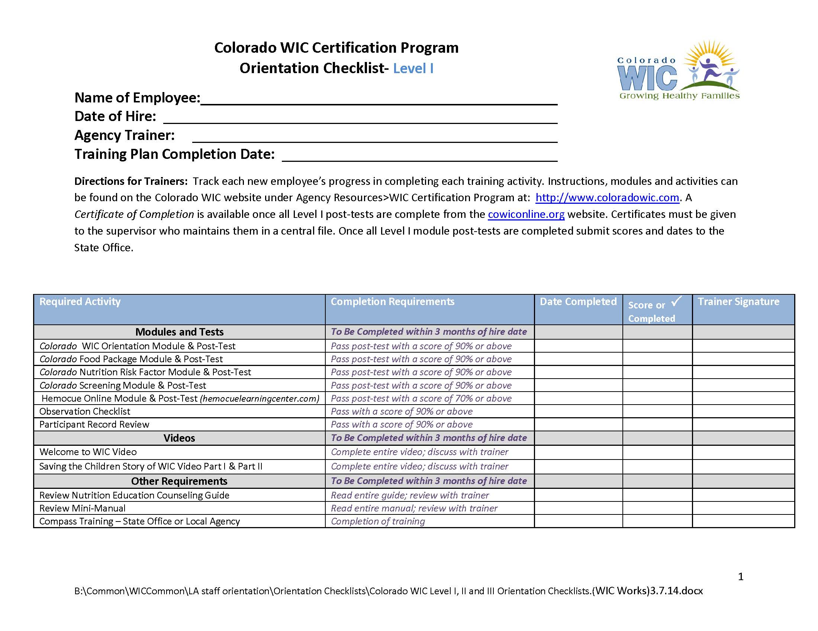
Notes:
For each level of new employee training an orientation checklist has been created. It includes required and recommended activities. This is a tool agencies can use to individualize the training based on the new employees learning needs and help keep the learning process on track for timely completion.

Slide 42
Online Resources
www.ColoradoWIC.com
(Local Agencies > WIC Certification Program)
WIC Works Resource Center
Notes:
The modules are available on the Colorado WIC website using the web address shown on your screen and navigating to the section title LA then to WIC certification training. Currently our training modules are being revised and updated for 2015. The most current materials will be located on our website. Eventually the updated modules will be posted to the WIC works resource center. The AI materials can also be found on our website under LA> Regional training

Slide 43
For more information
Lynn Ireland
lynn.ireland@state.co.us or 303.692.2446
Brigitte Boyd
brigitte.boyd@state.co.us or 303.692.2380
Notes:
Our final slide provides contact information. If you would like more information or have additional questions after the presentation you may contact myself or Lynn Ireland. At this time we would like turn it back over to open the Question & Answer session. Thank you.

Slide 44
Additional Questions
Please contact Lynn Ireland if you have additional questions about the Colorado WIC VENA project.
If you have questions about VENA in general please contact your respective FNS Regional office.

Slide 45
Thank you!
Thank you for your participation.
Thank you for your hard work.
Stay tuned for the next webinar scheduled for: April 29, 2015!
Notes:
Thank you for joining us on today’s webinar. Also, thank you for your hard work.
Please stay tuned for the next VENA webinar scheduled for April 29, 2015.

